Slide 1
Remembering Our Ancestors

Slide 2
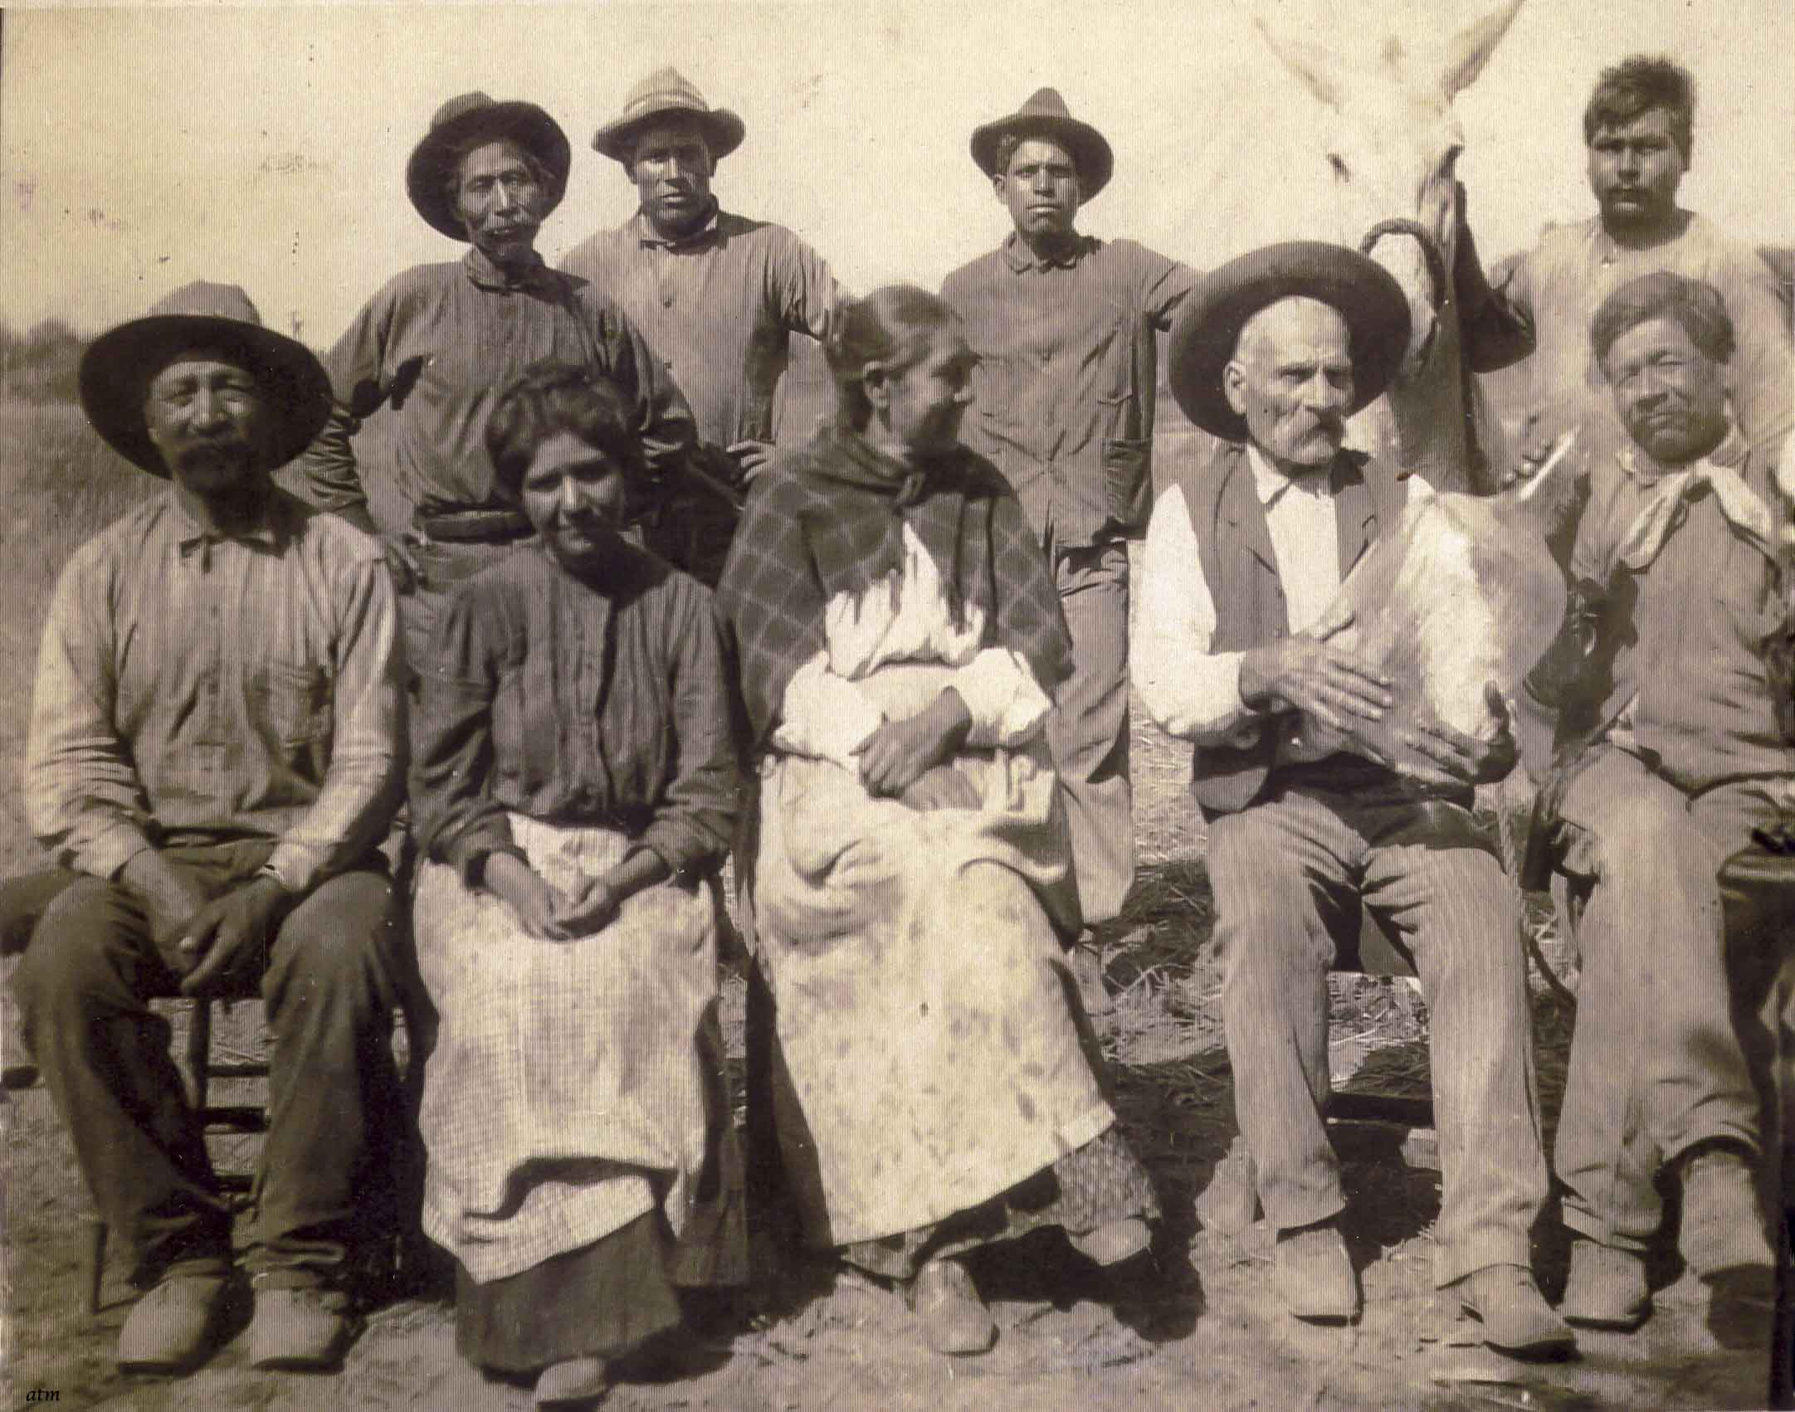
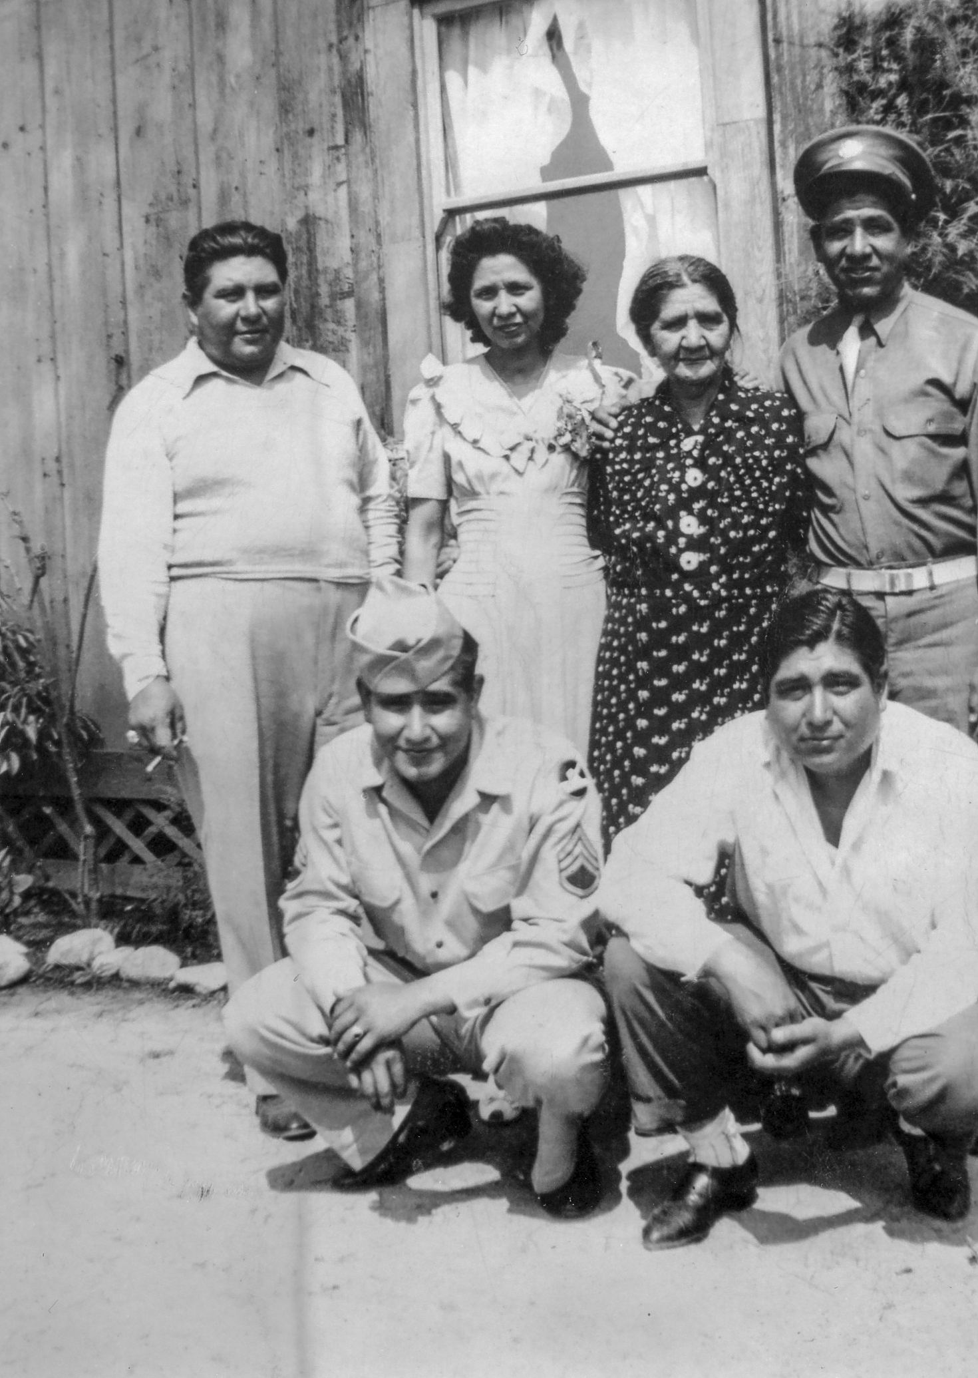
Morales Family
Front Row from Left: Francisco Valenzuela, Modesta Valenzuela Morales, and Soledad Valenzuela with family. Back Row: unidentified.
ca. 1890s
Modesta Valenzuela Morales (back row, second from right) with her children outside her home.
ca. 1940
Notes:
S

Slide 3
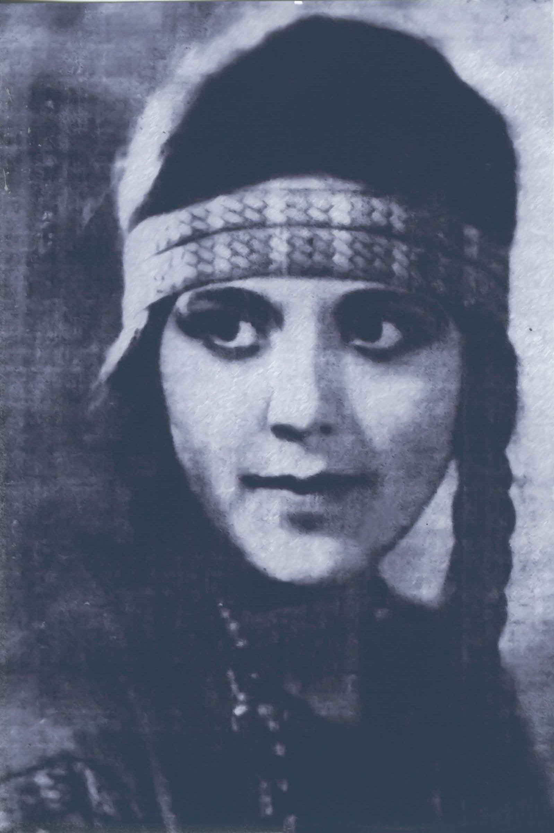
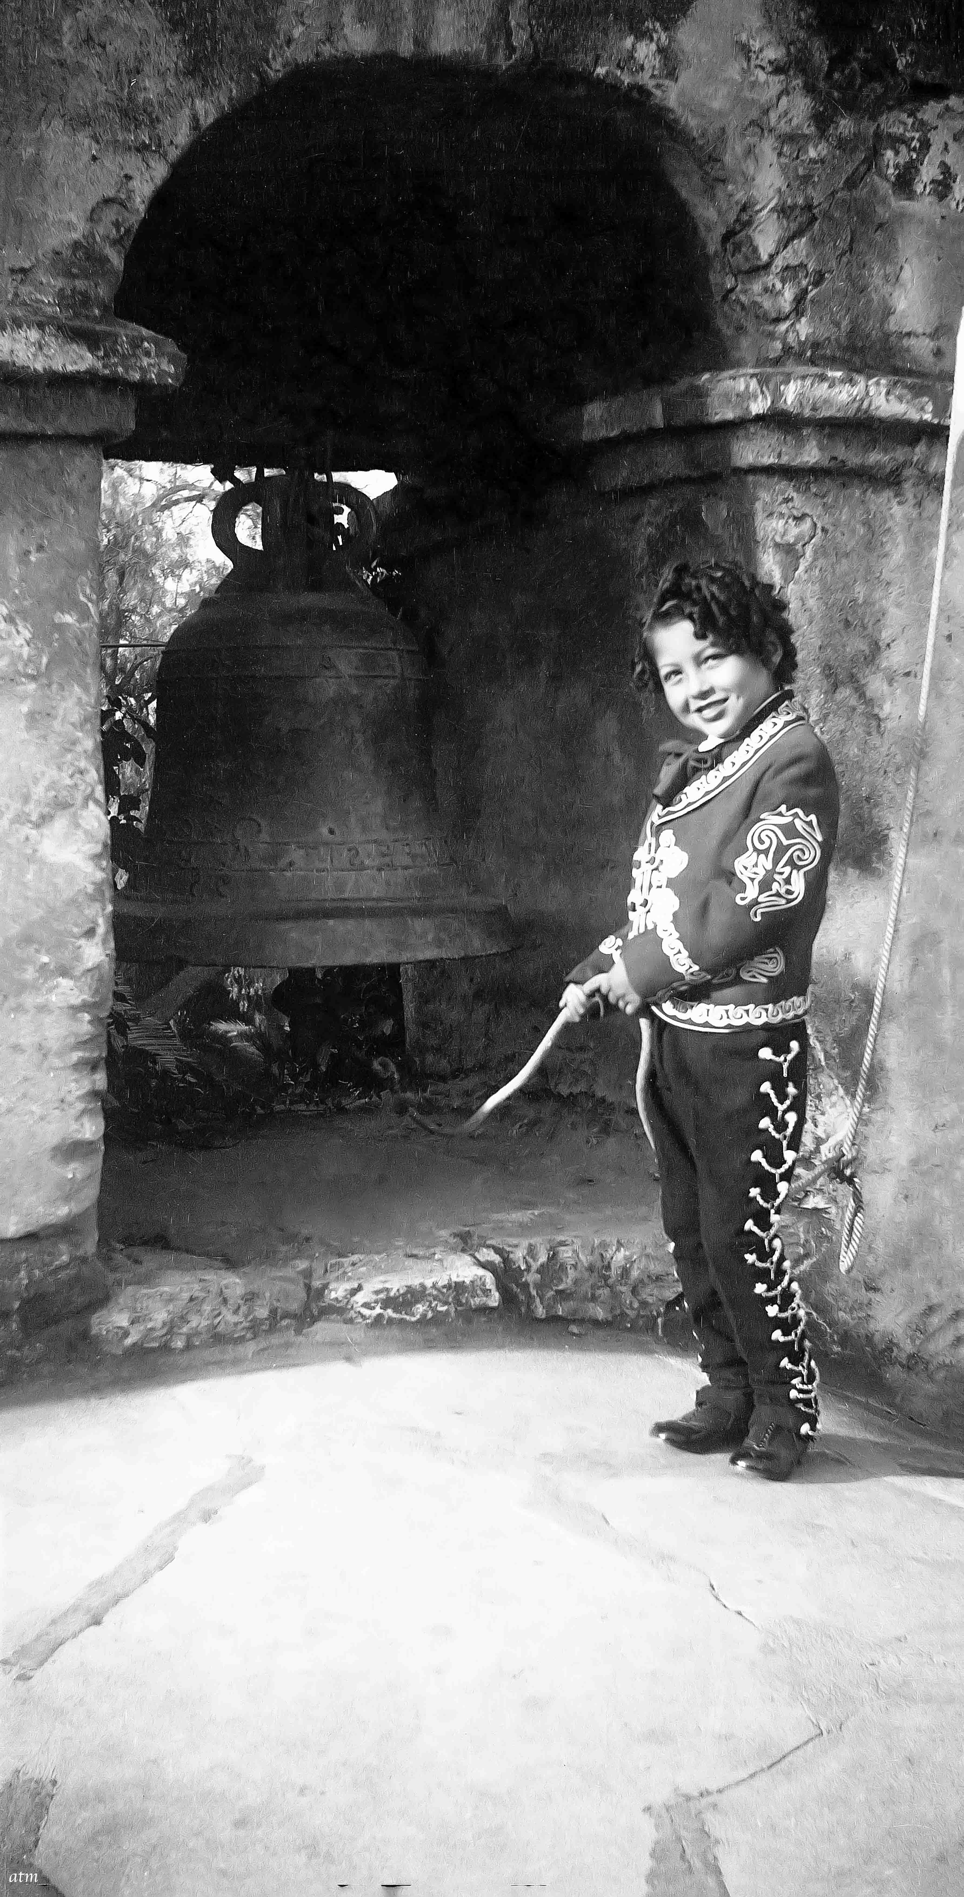
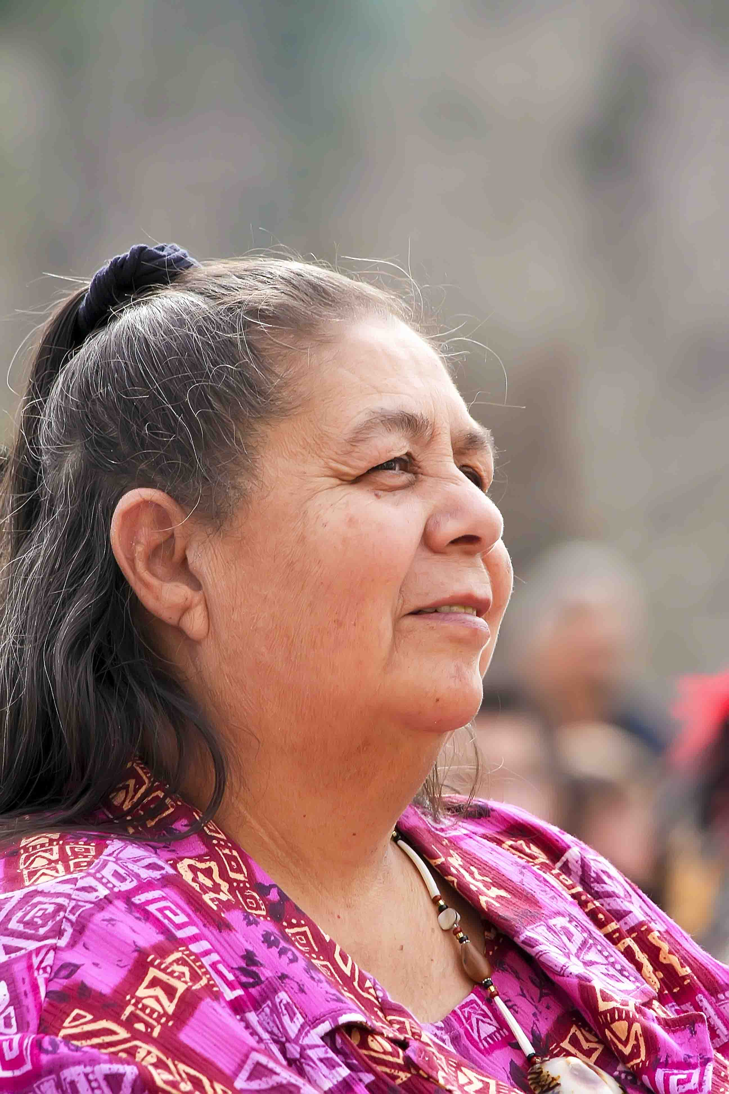
Bea Alva
Vivian Morales Barthelemy
ca. 1935
Julia Bogany

Slide 4
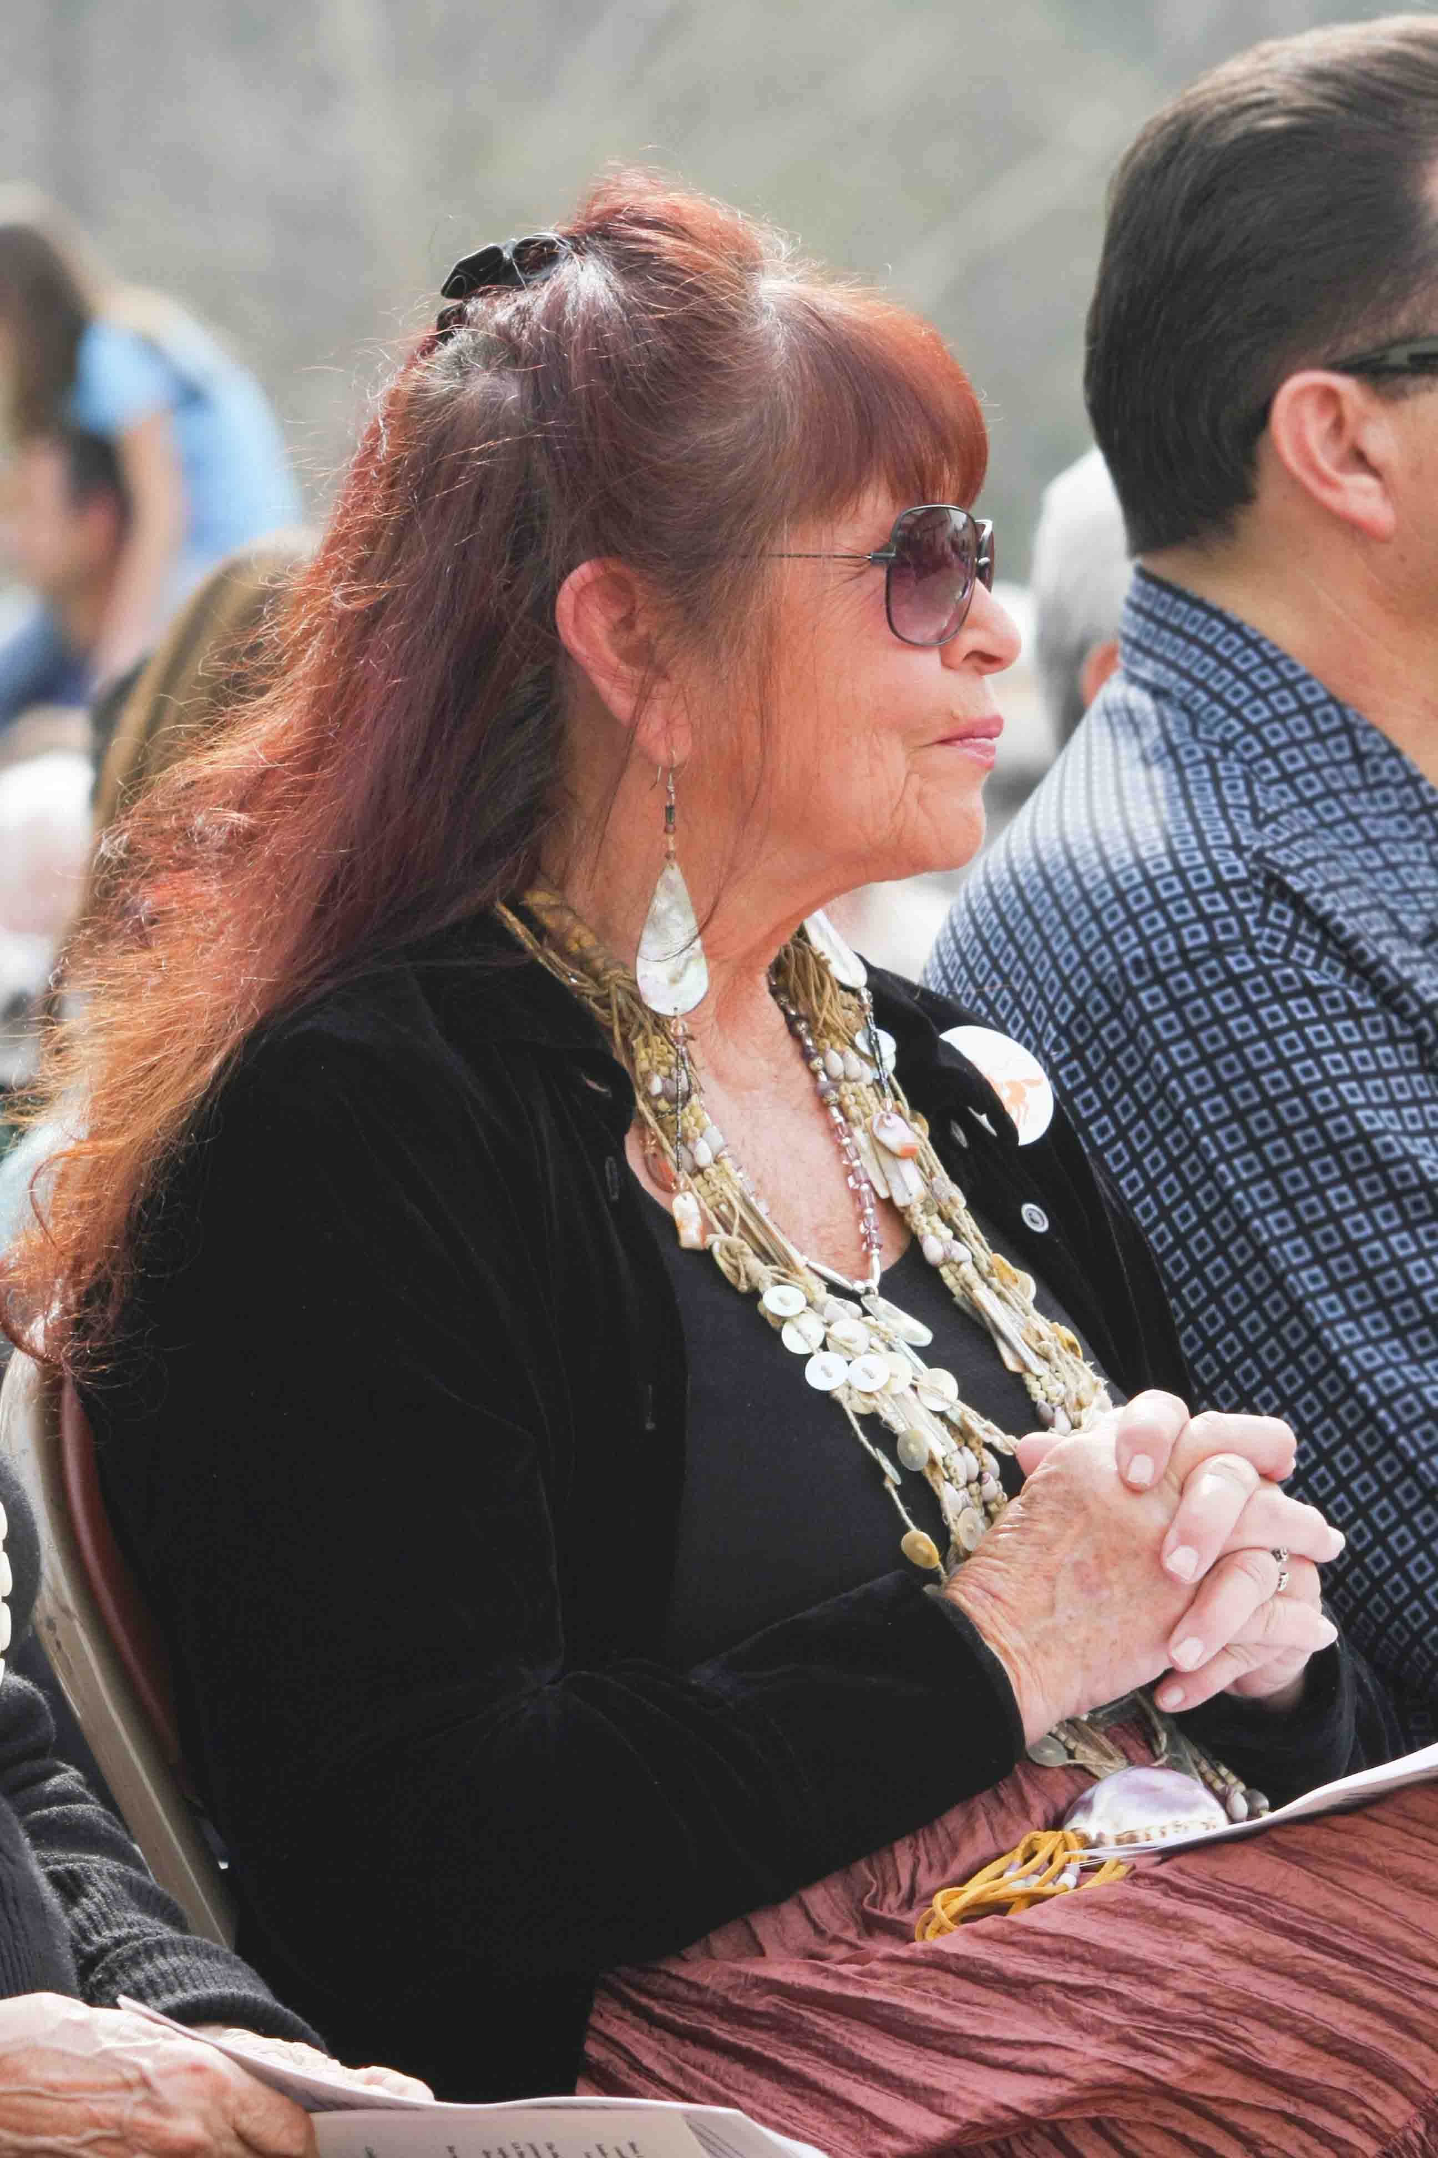
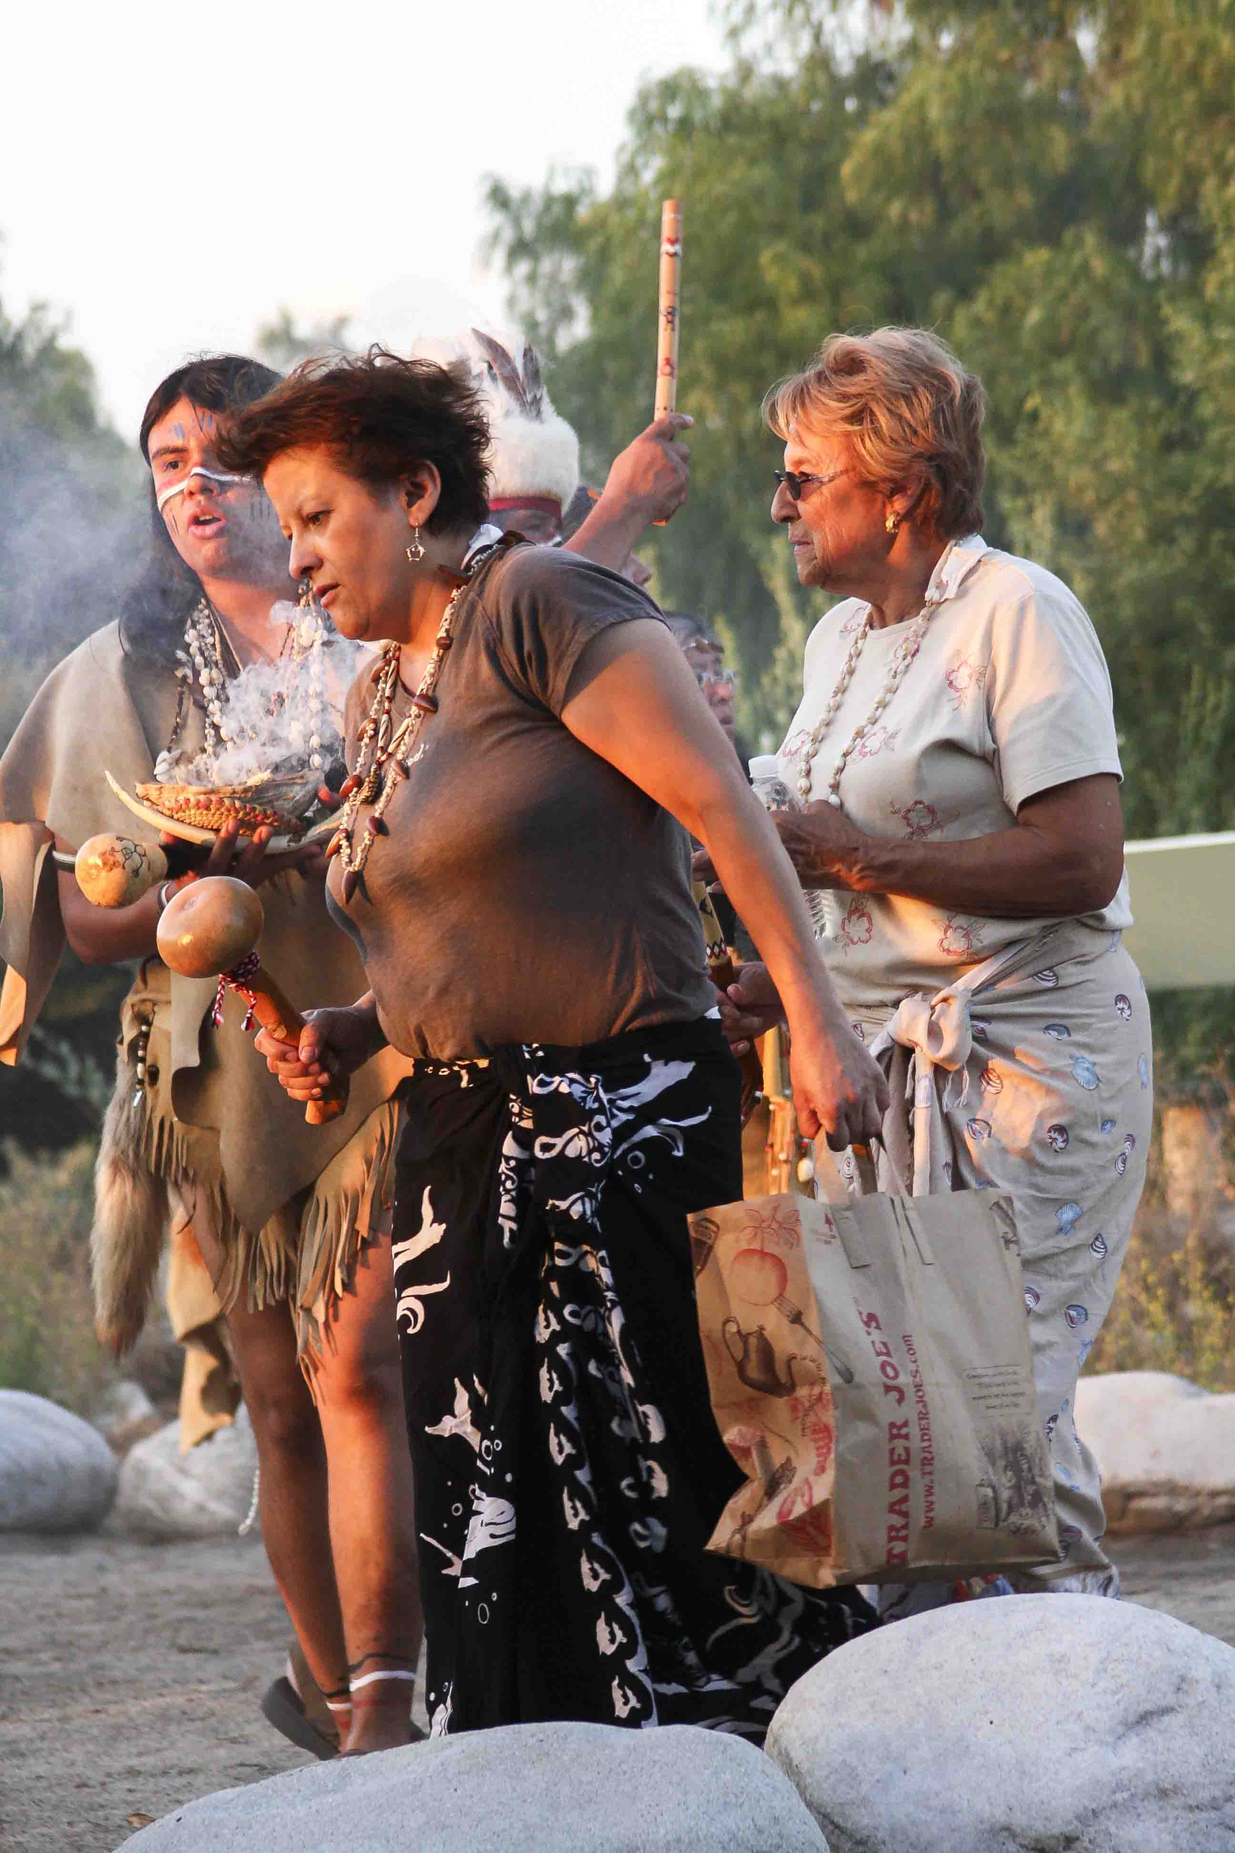
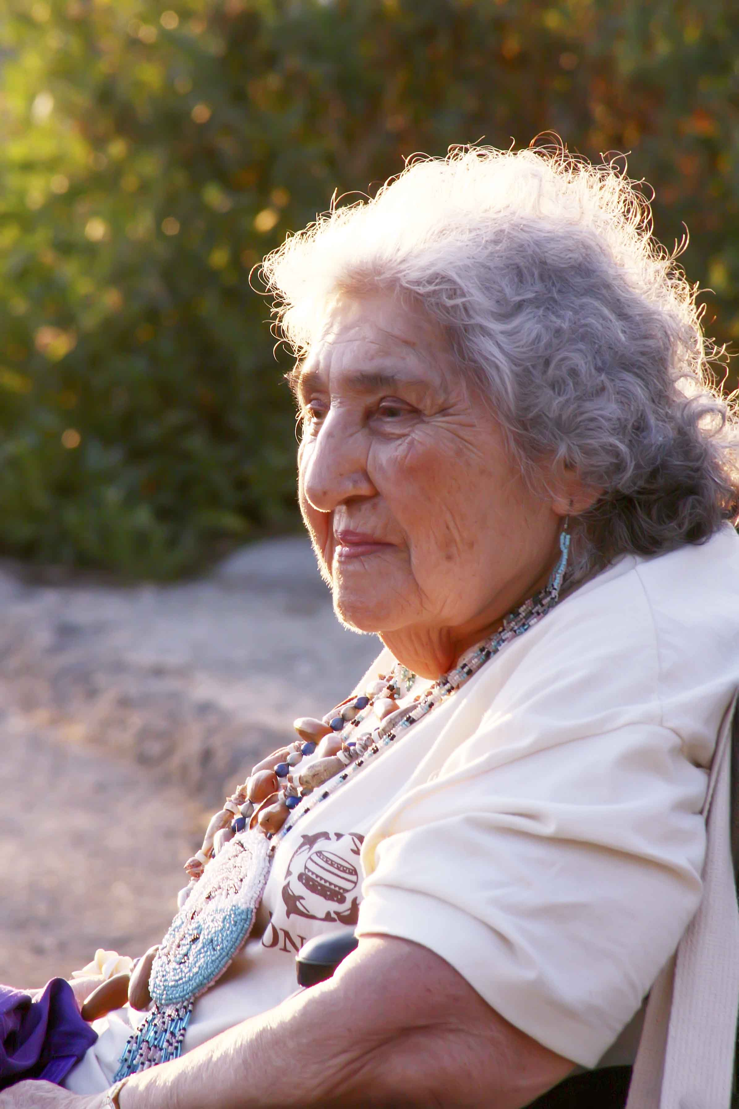
Barbara Drake
date?
Carol Ramirez
date?
Irene Verdugo
date?

Slide 5
Leadership and Community Engagement

Slide 6
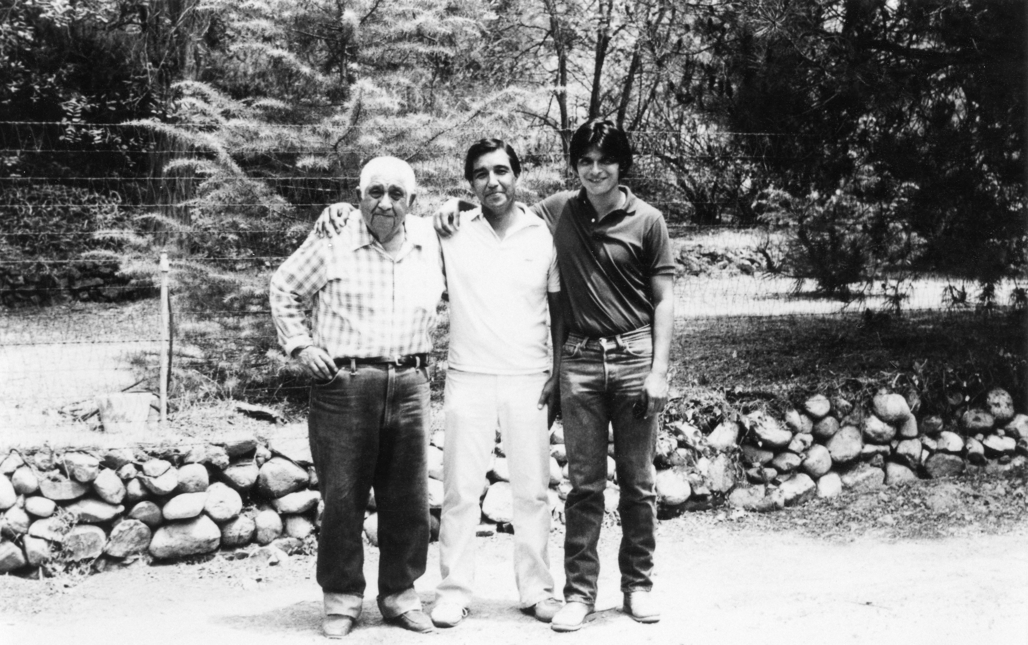
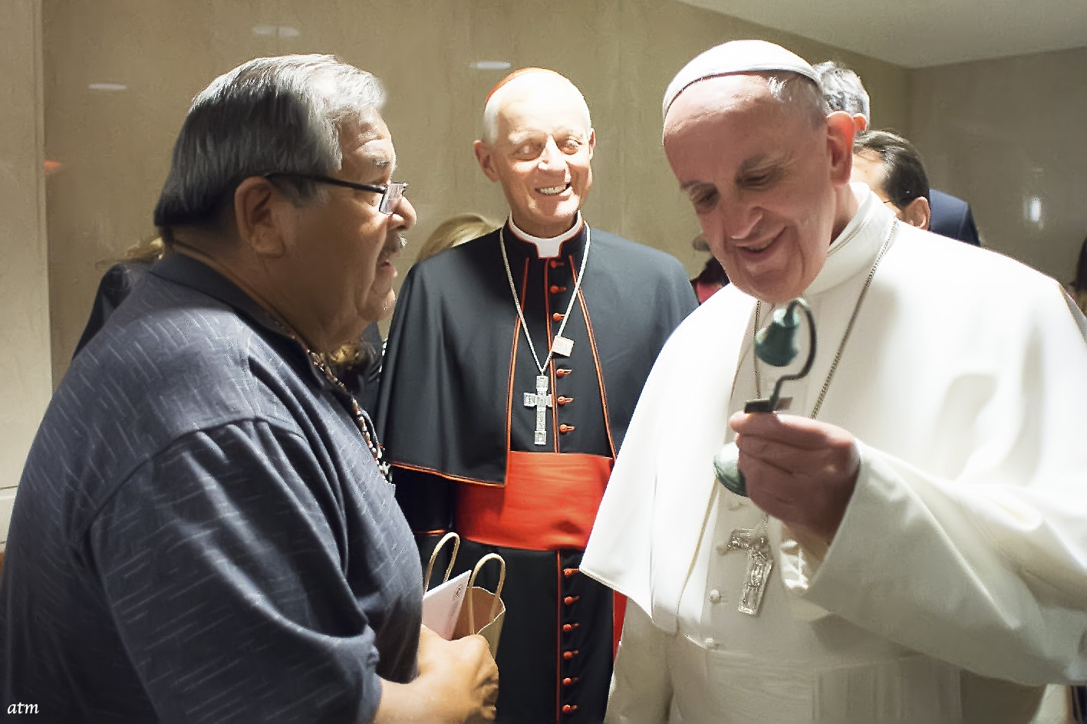
Fred "Sparky" Morales (Former Gabrieleno/Tongva Chief and father of Chief Red Blood Anthony Morales), Art Morales, and Michael Barthelemy
1970s
Chief Red Blood Anthony Morales (Gabrieleno/Tongva San Gabriel Band of Mission Indians Chairman) and Pope Francis
2015

Slide 7
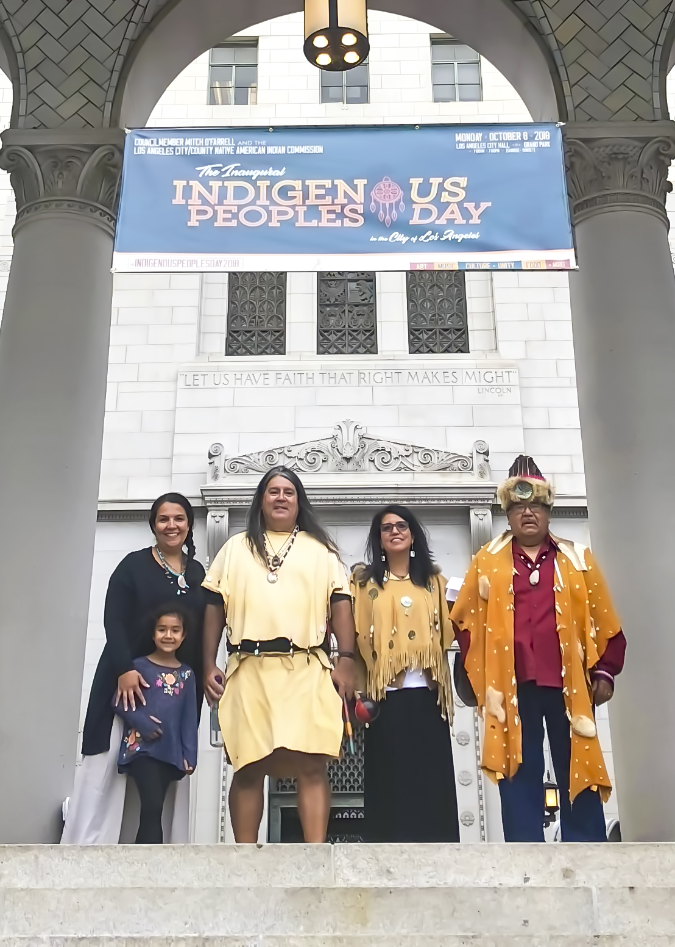
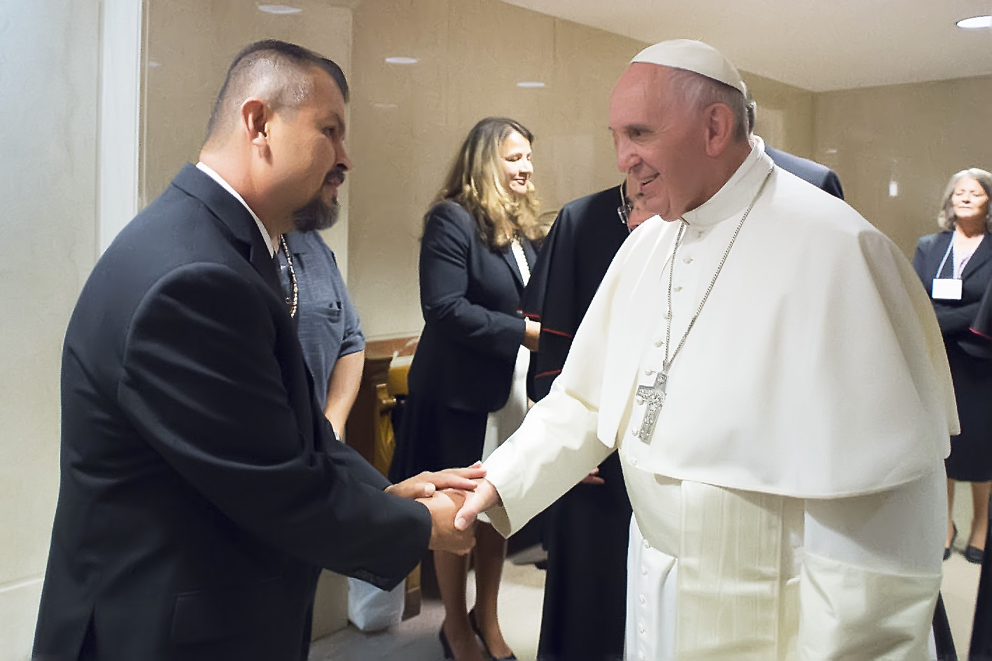
Reggie Morales (Gabrieleno/Tongva San Gabriel Band of Mission Indians Vice Chairman) and Pope Francis
2015
Mona Morales Recalde, Ellie Morales Recalde, ____???___, Kimberly Morales Johnson, Chief Red Blood Anthony Morales
2017

Slide 8
Celebrating our Culture

Slide 9
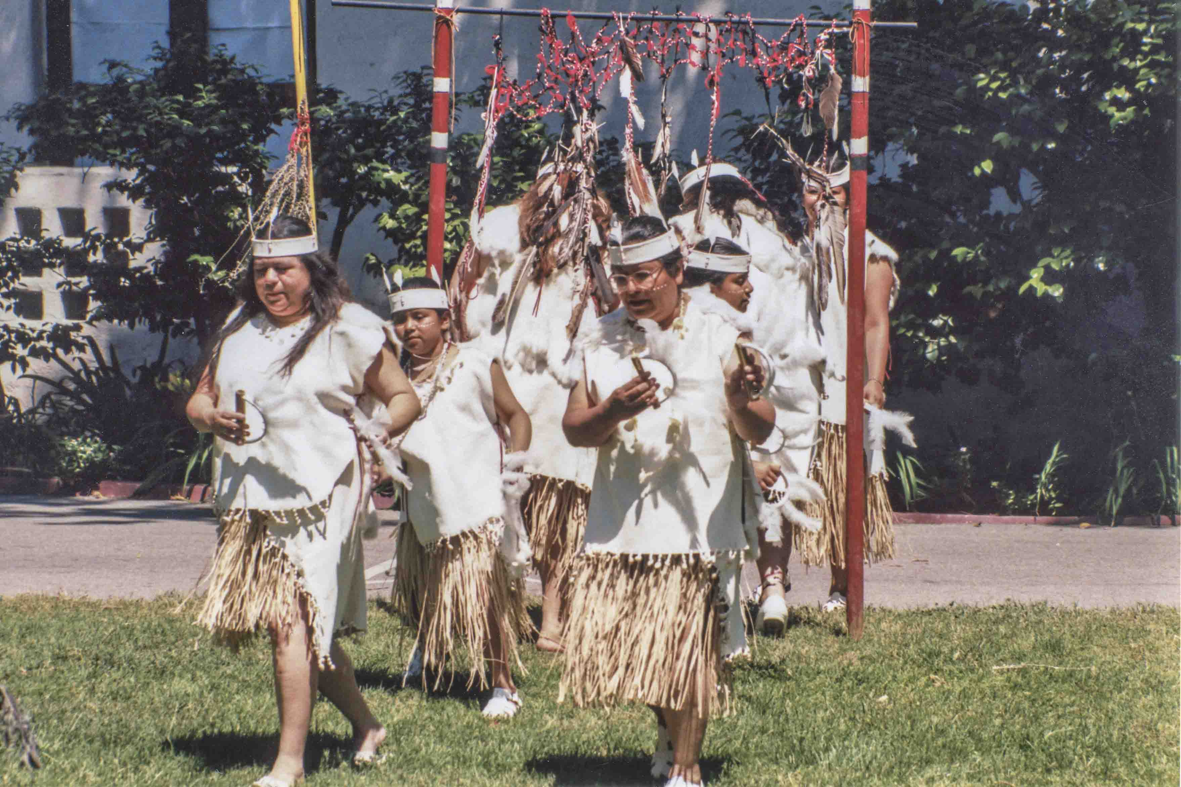
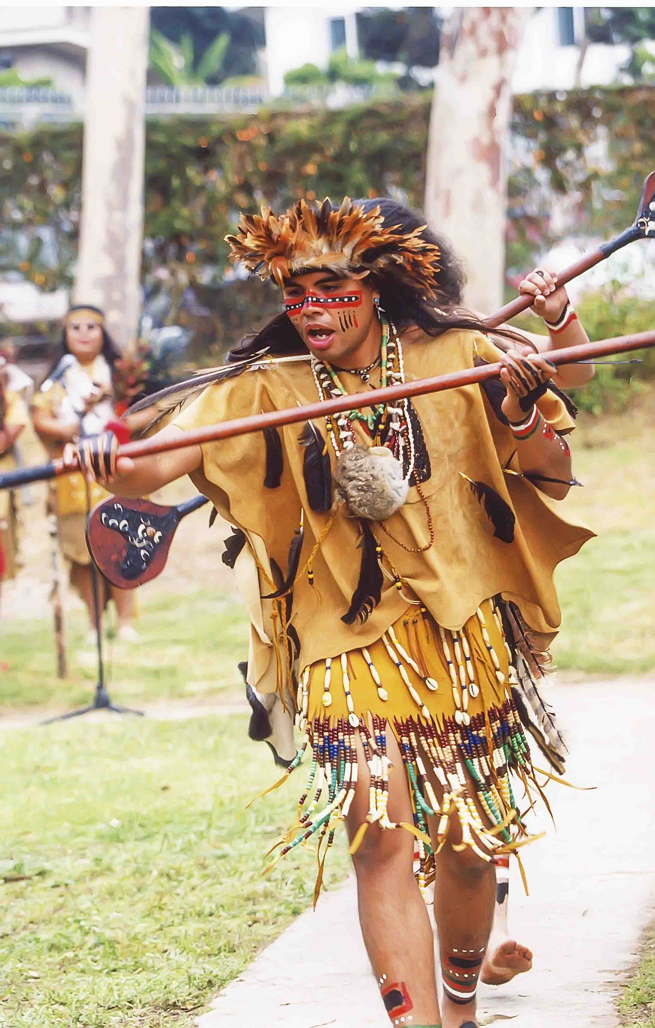
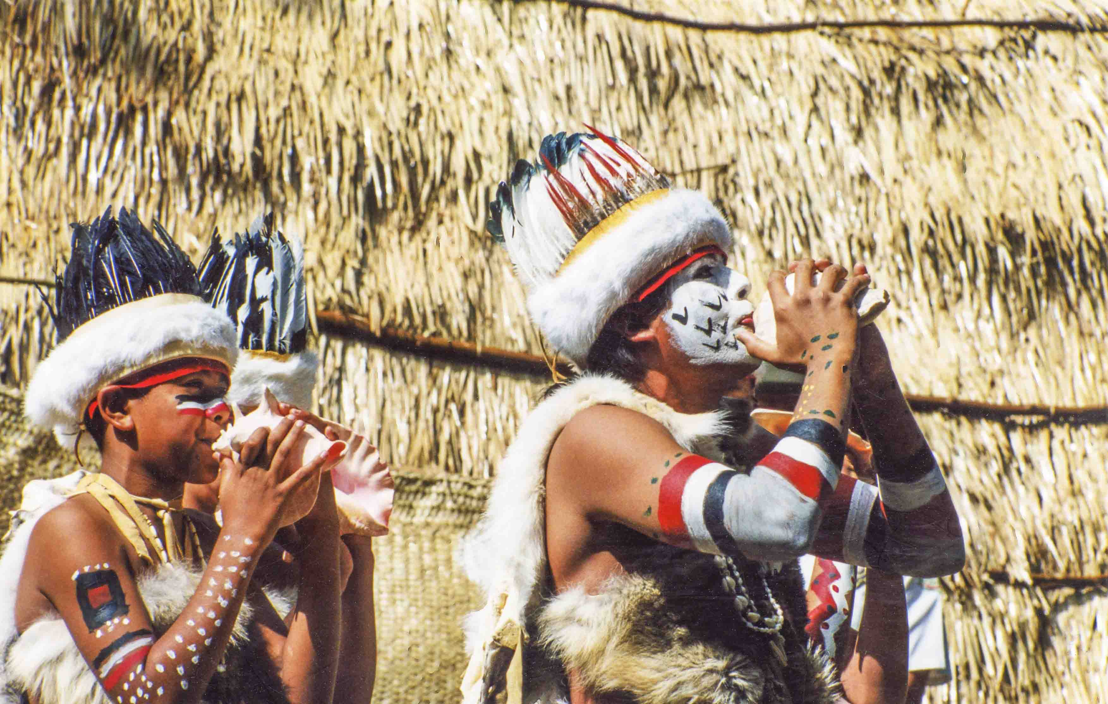
Andrew Morales

Slide 10
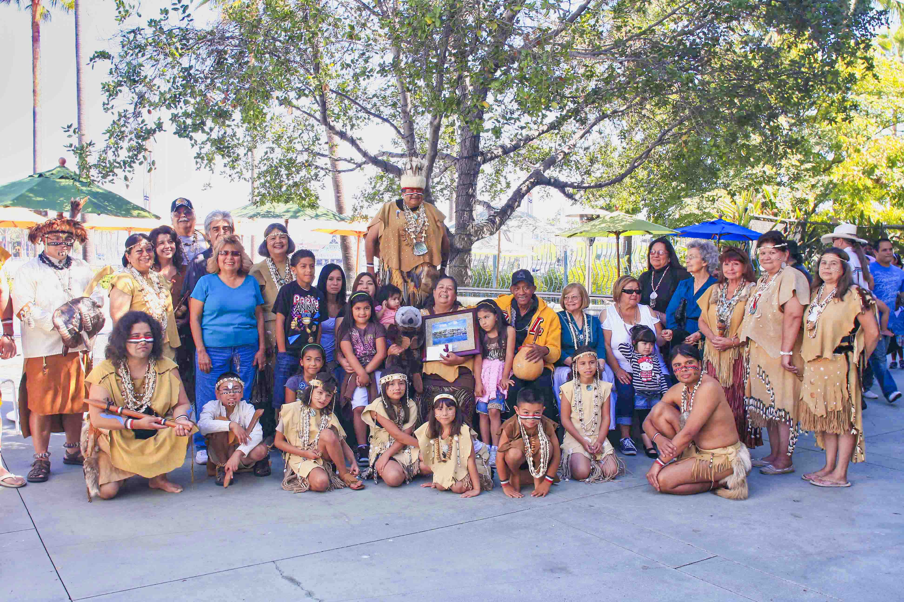
Names, date?
Tribal Elder Julia Bogany (center) honored by the Long Beach Aquarium of the Pacific with members of the Gabrieleno/Tongva community
2010

Slide 11
Honoring Our Elders

Slide 12
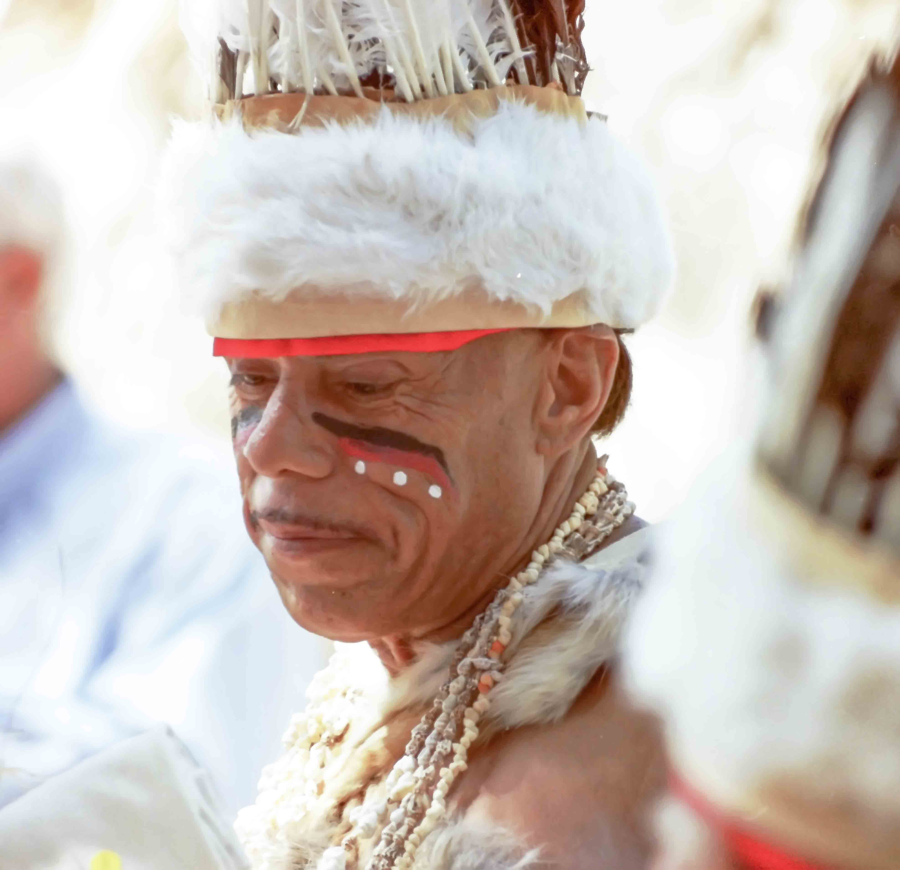
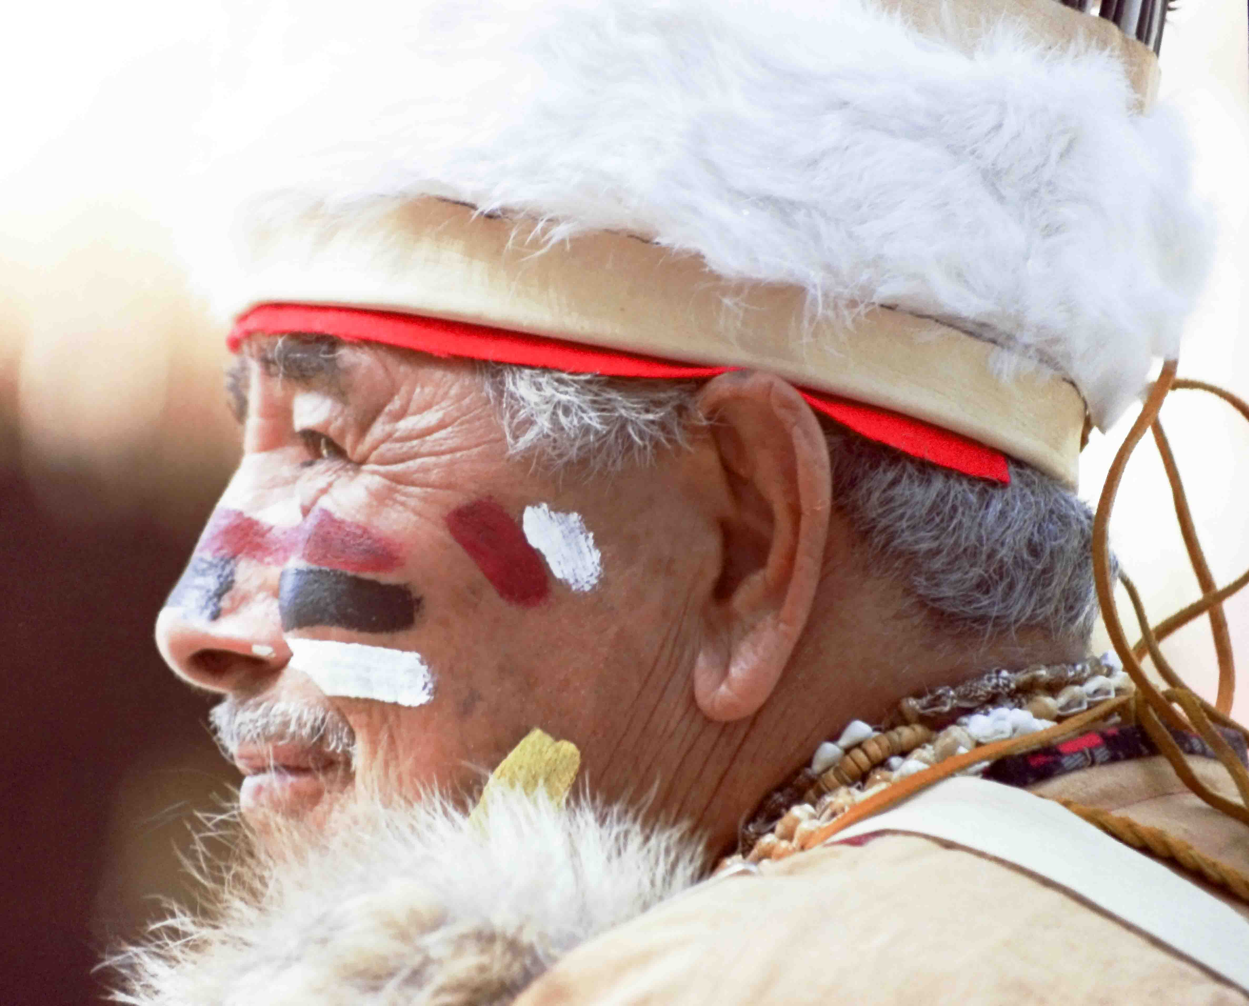
Alfred Garcia
Joe Lucero

Slide 13
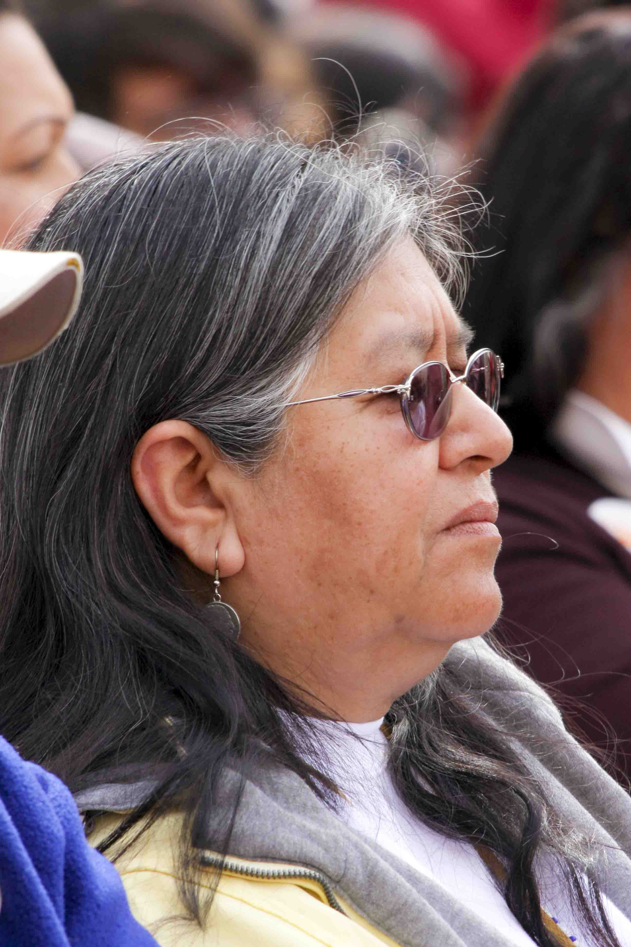
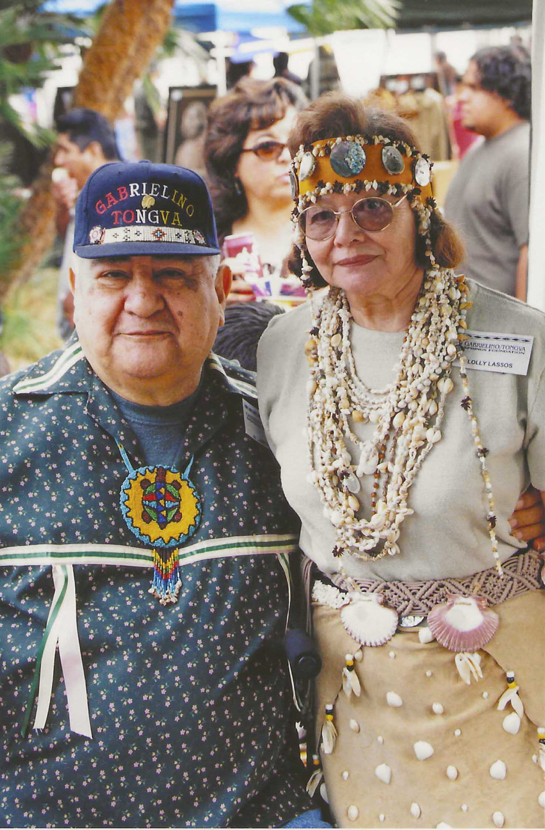
June Barajas
Al and Lolly Lasso

Slide 14
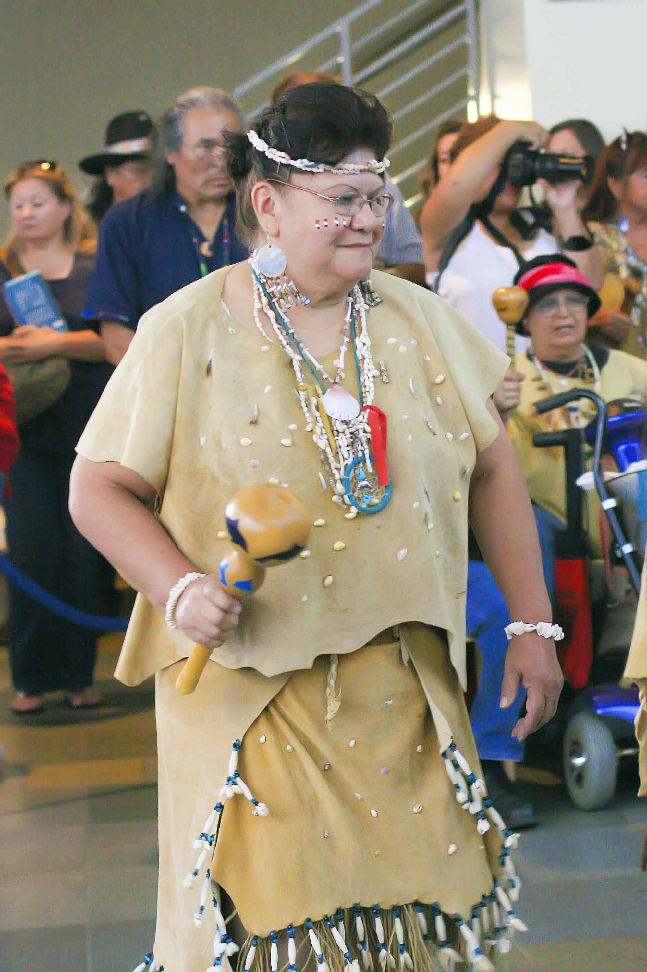
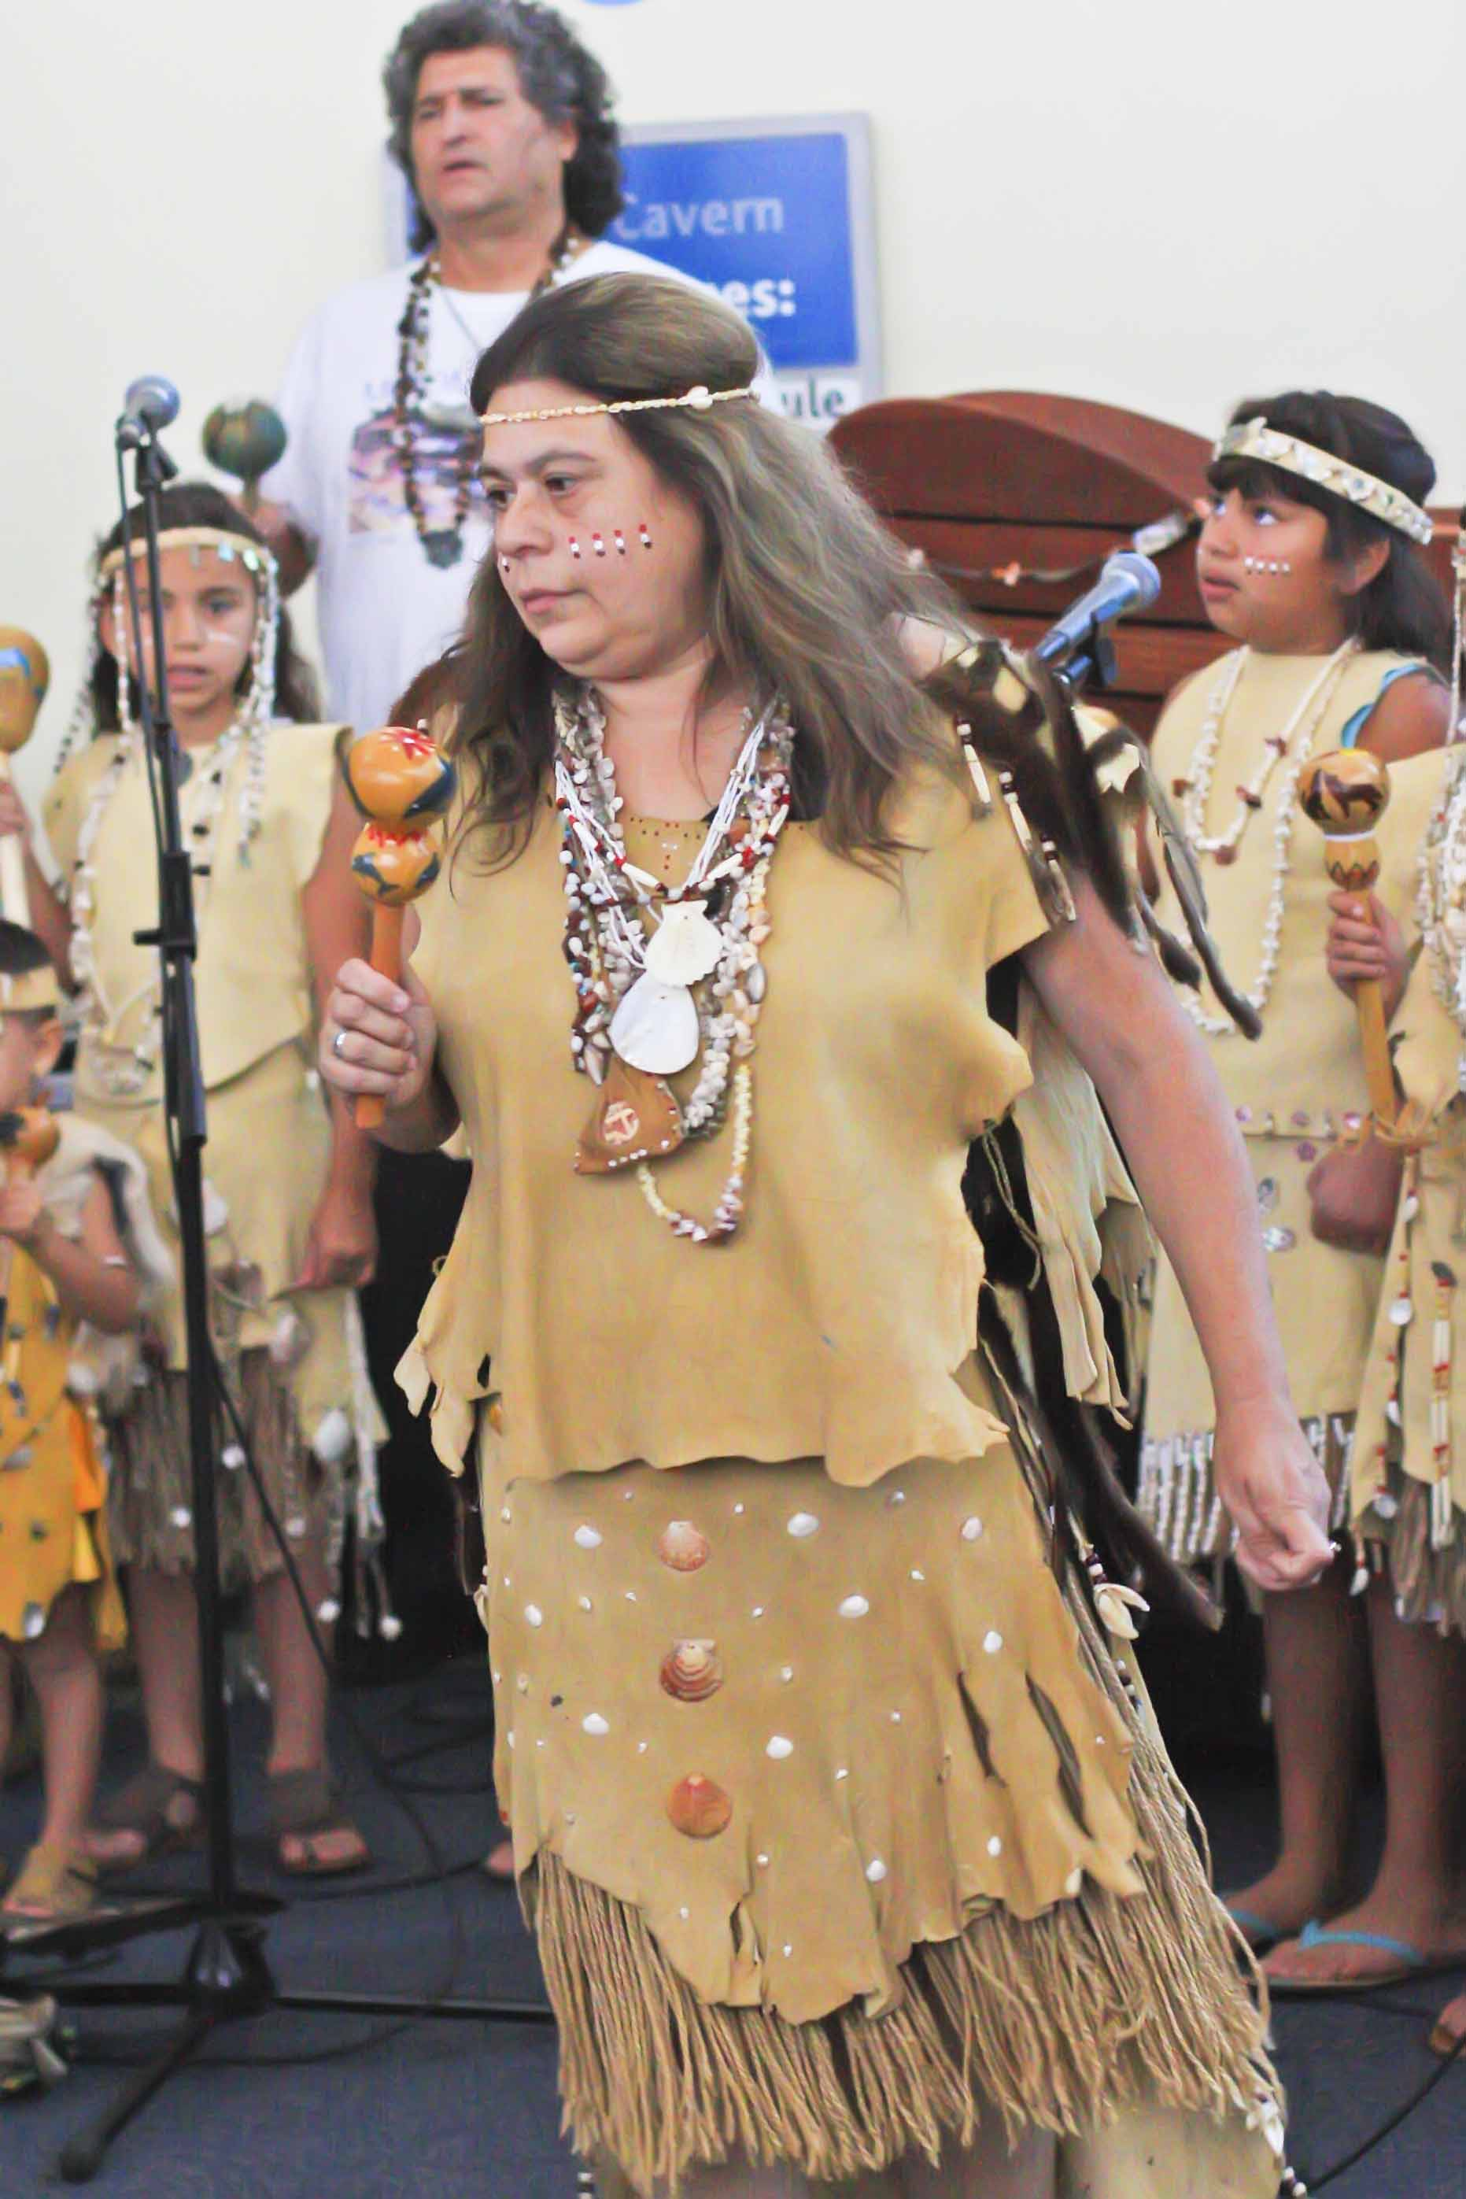
Della Garcia
Dee Roybal

Slide 15
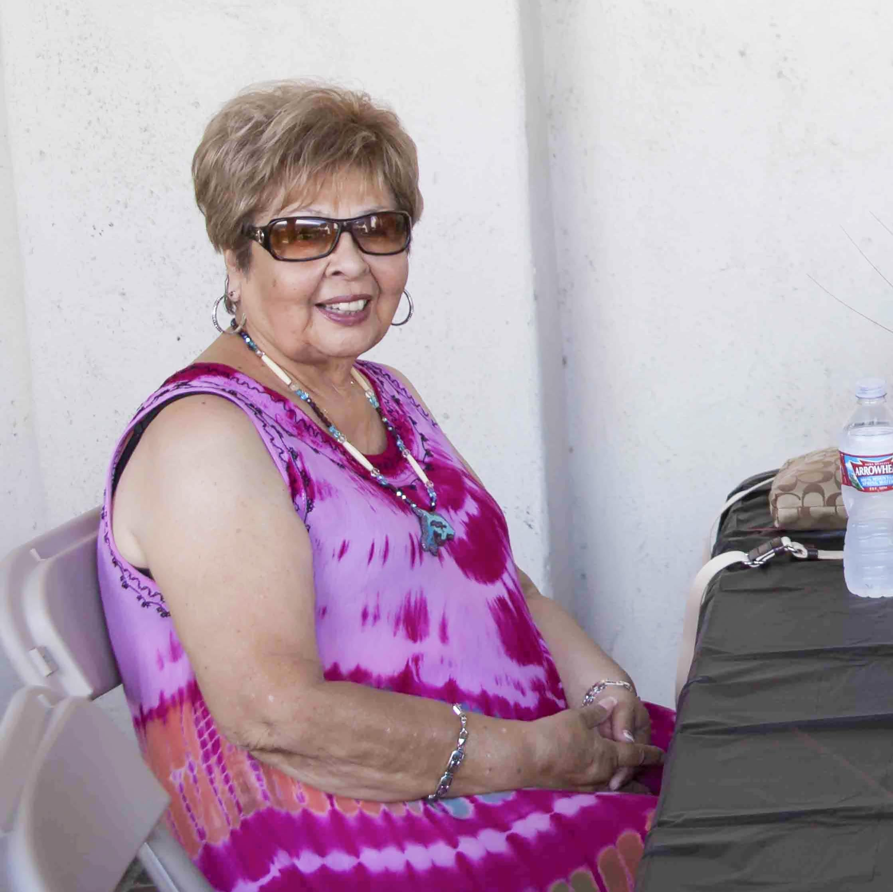
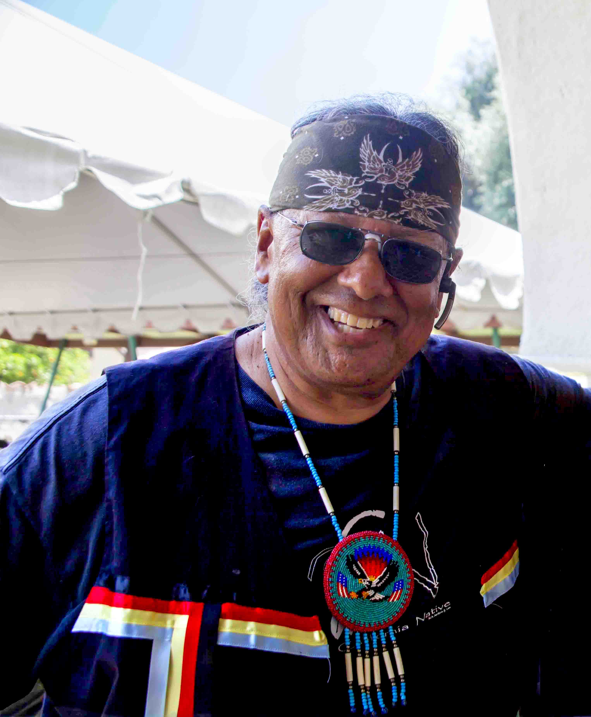
Jeannette Ramirez date?
Michael "White Horse" Aviles
date?

Slide 16
The Future

Slide 17
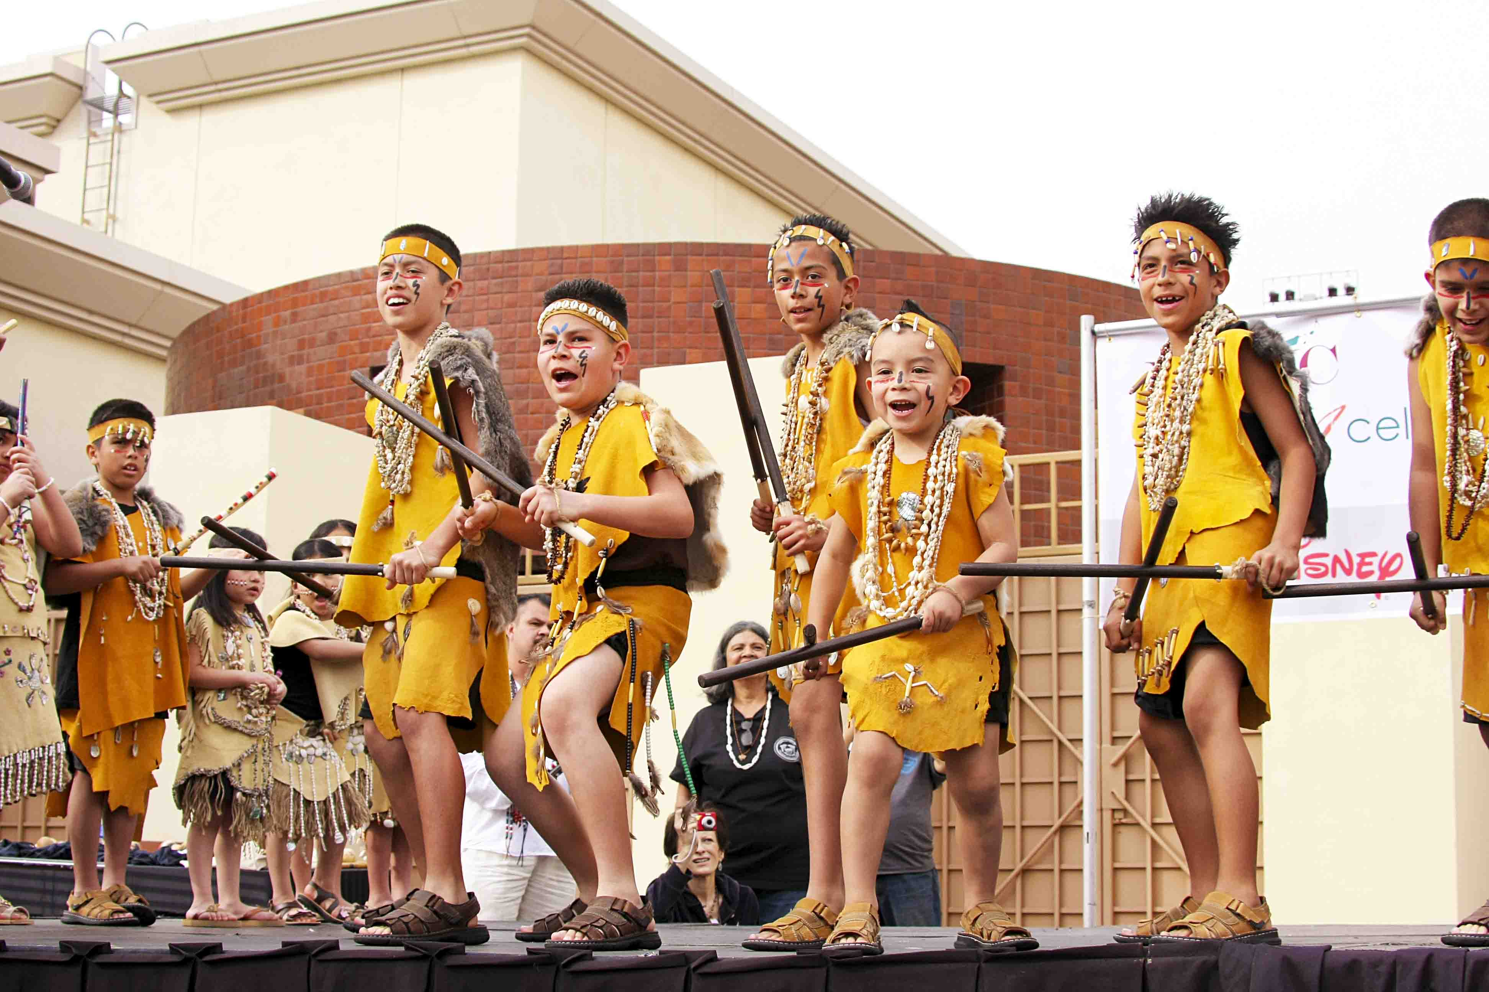
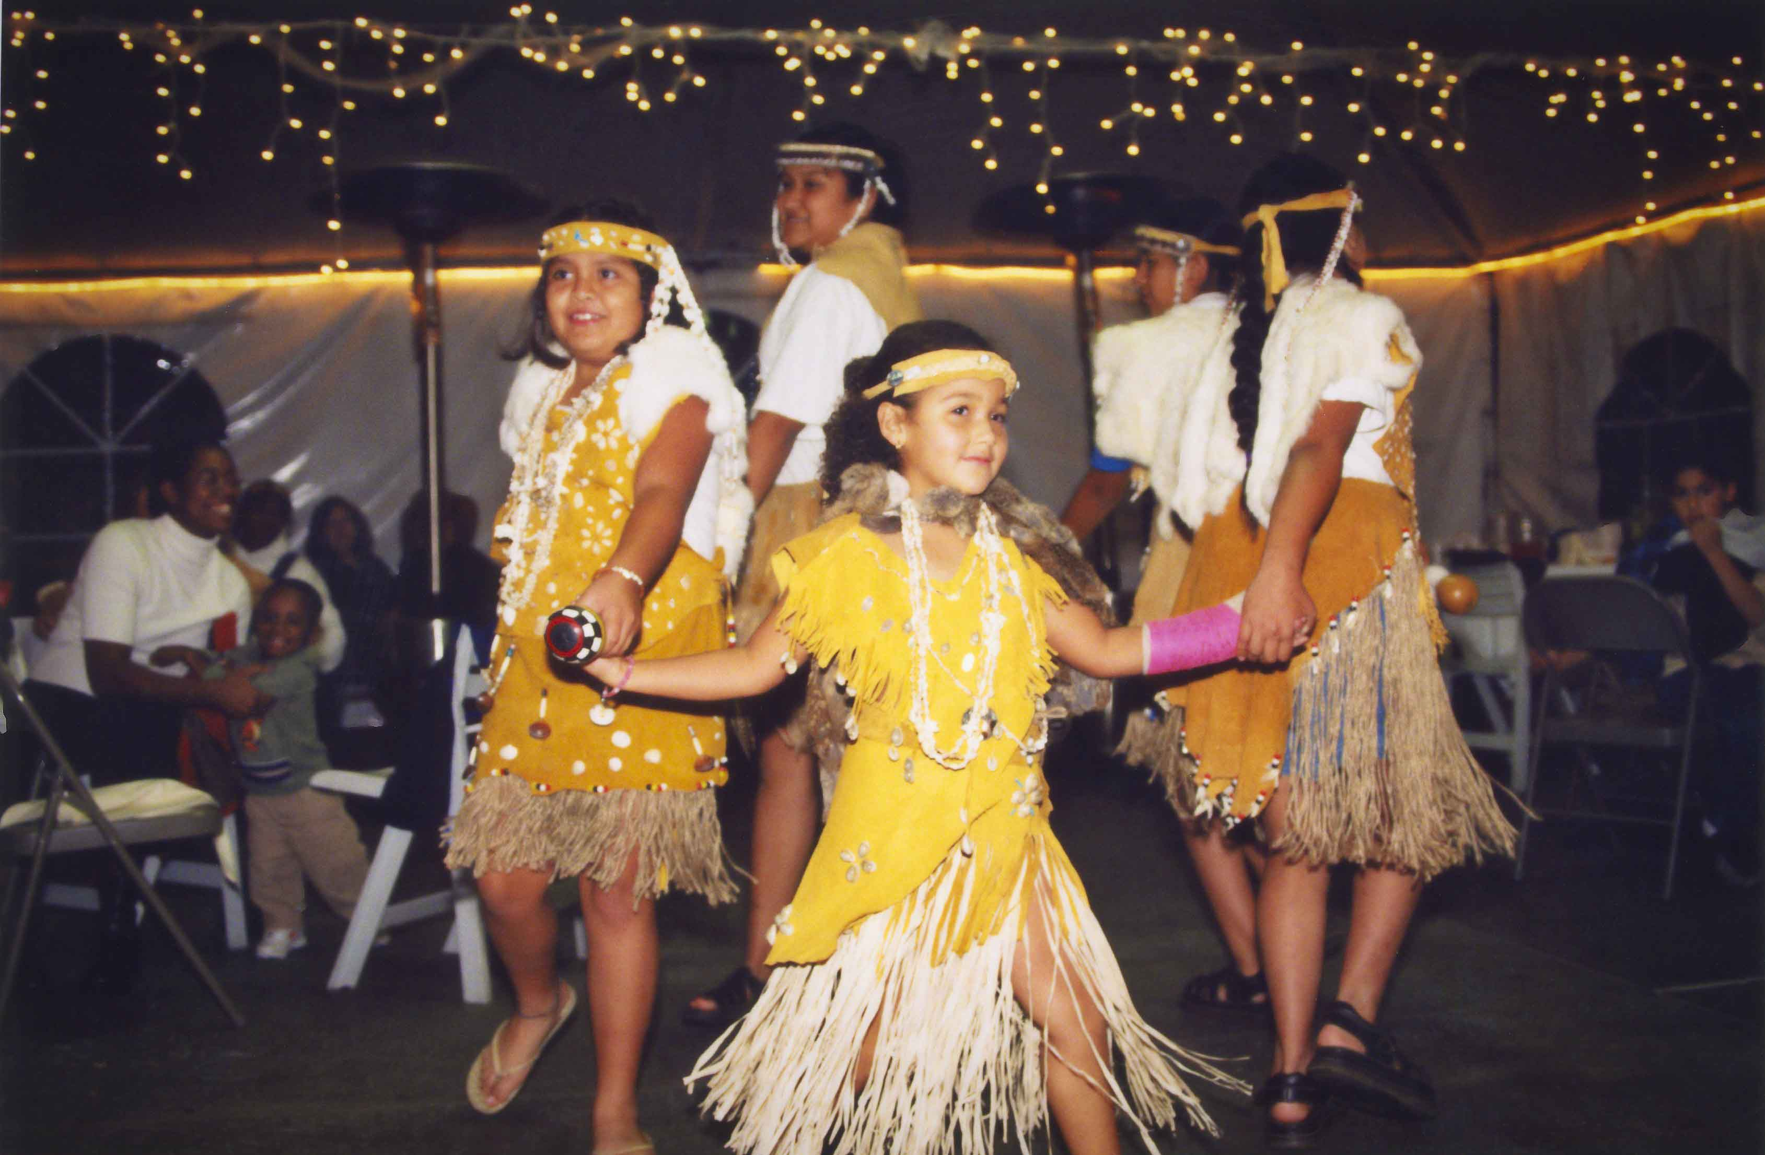
Samantha Johnson (center) with ?

Slide 18
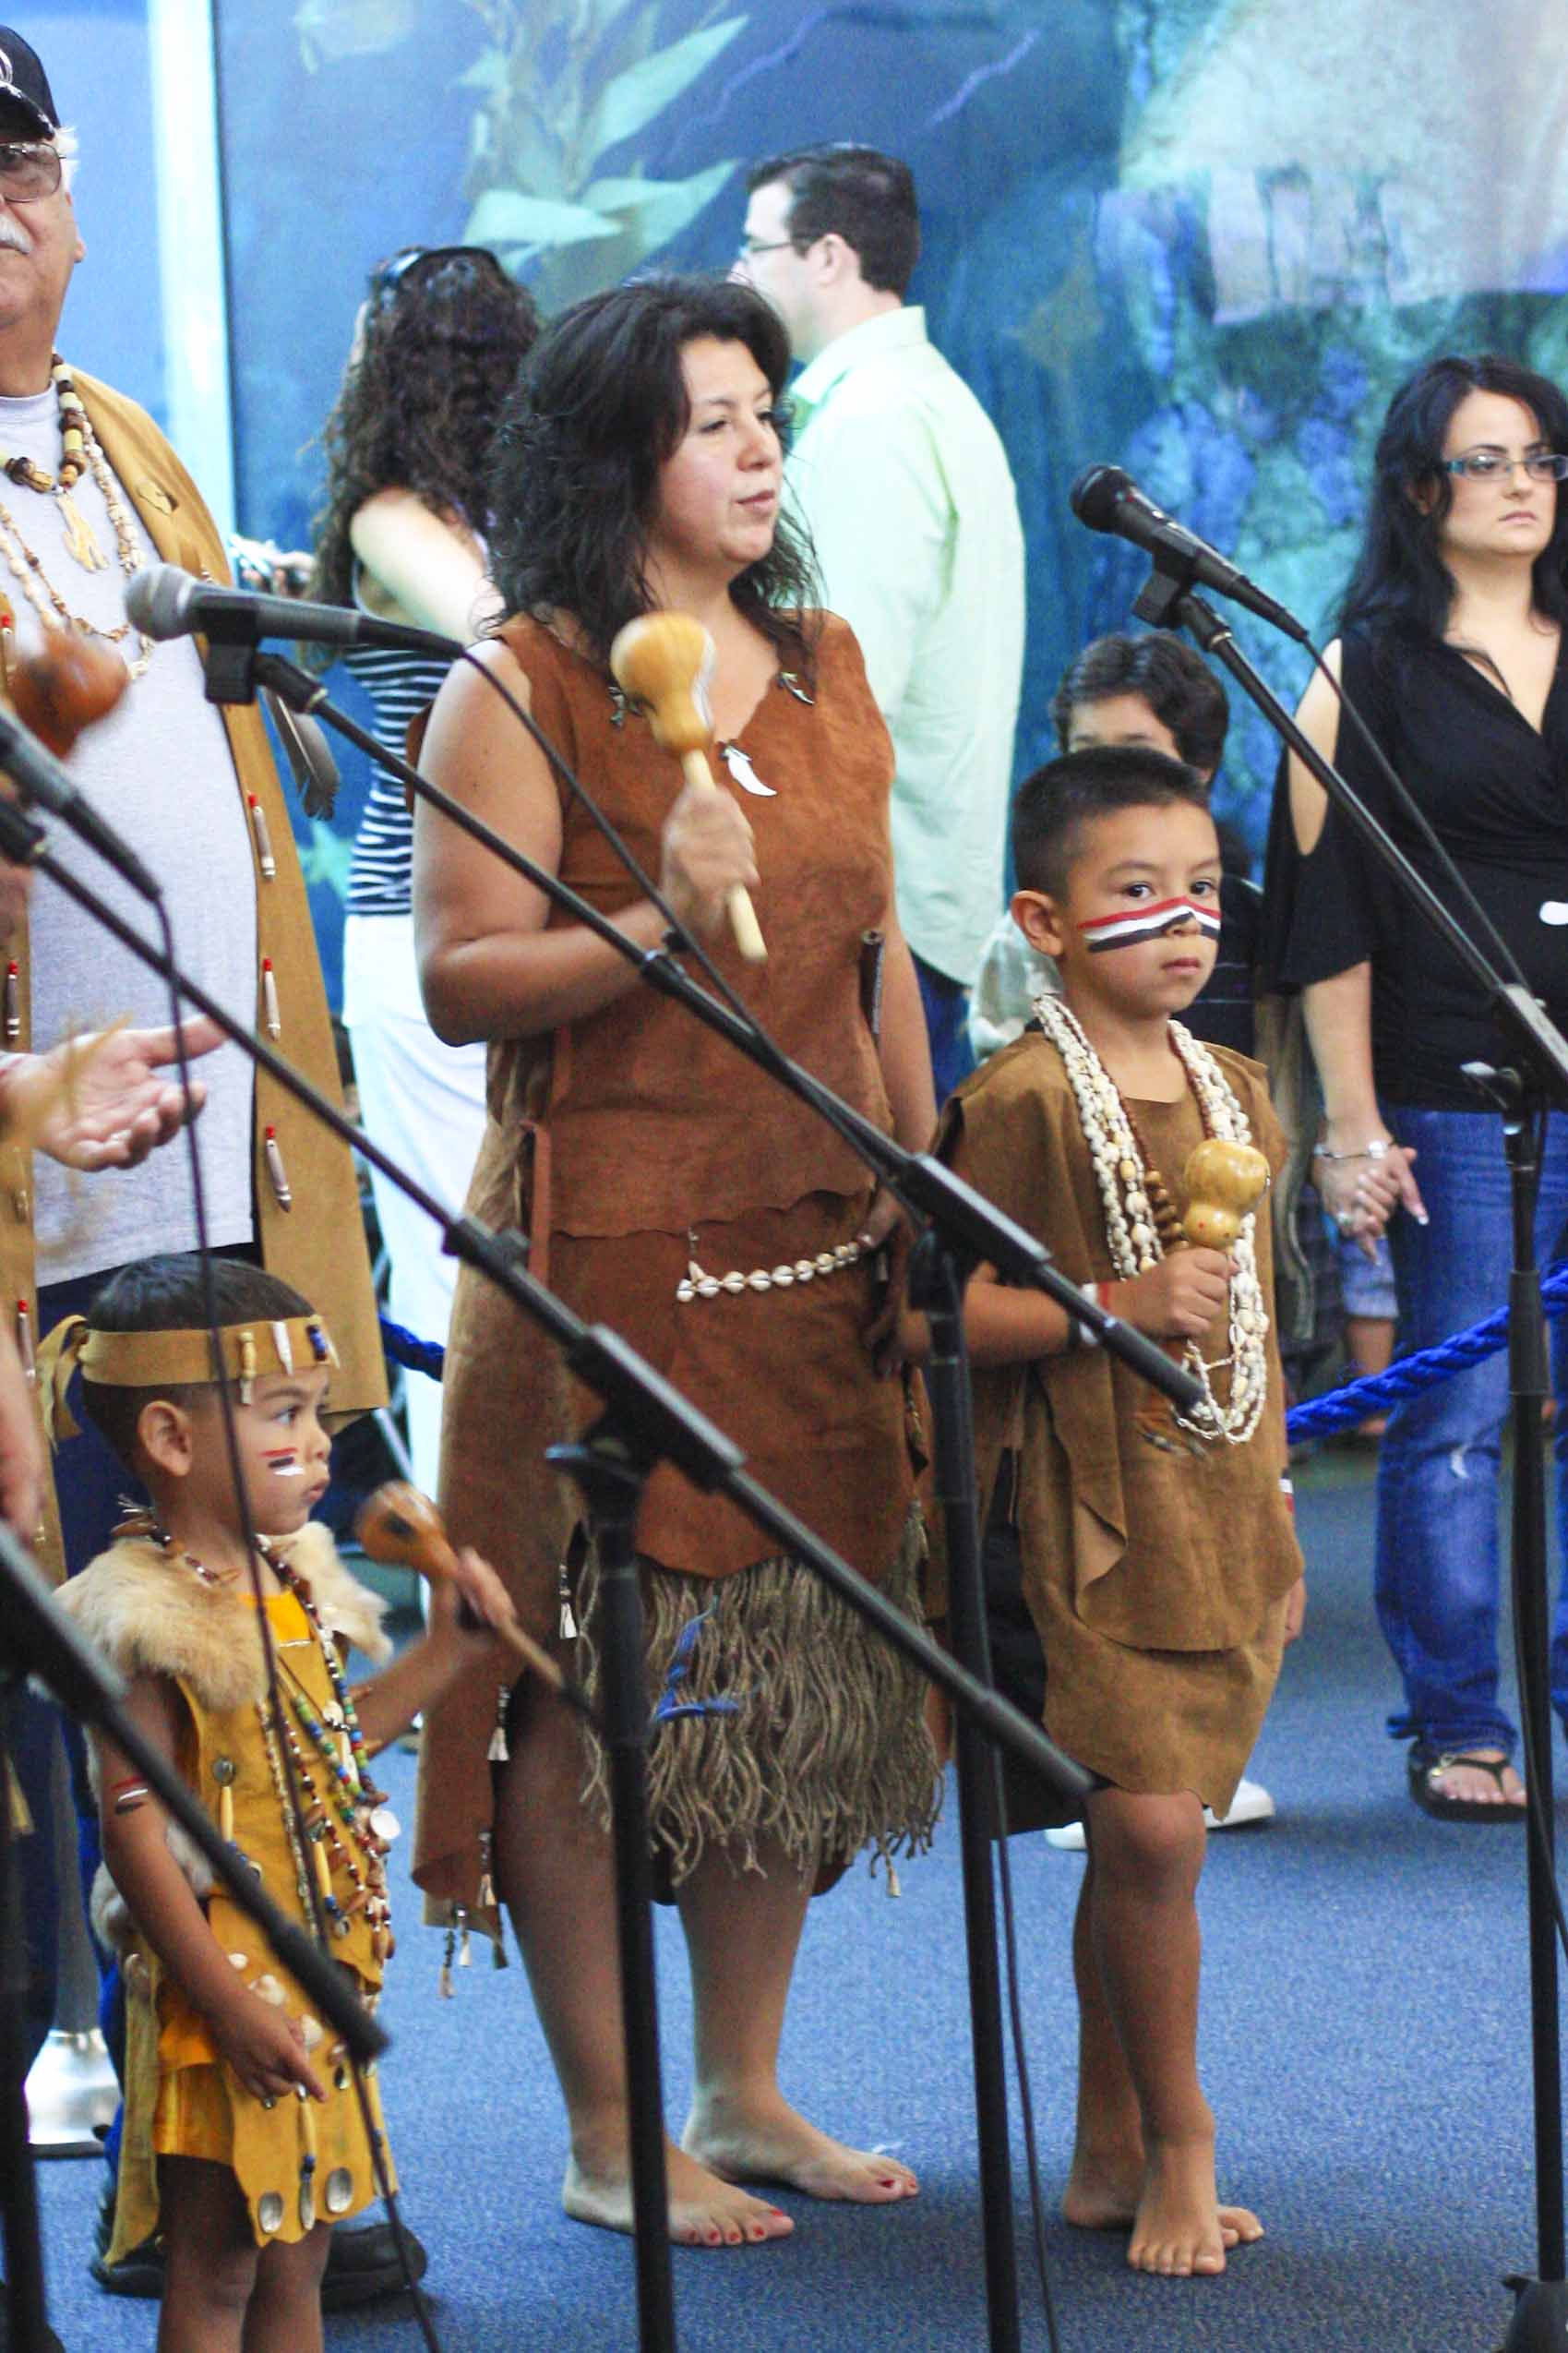
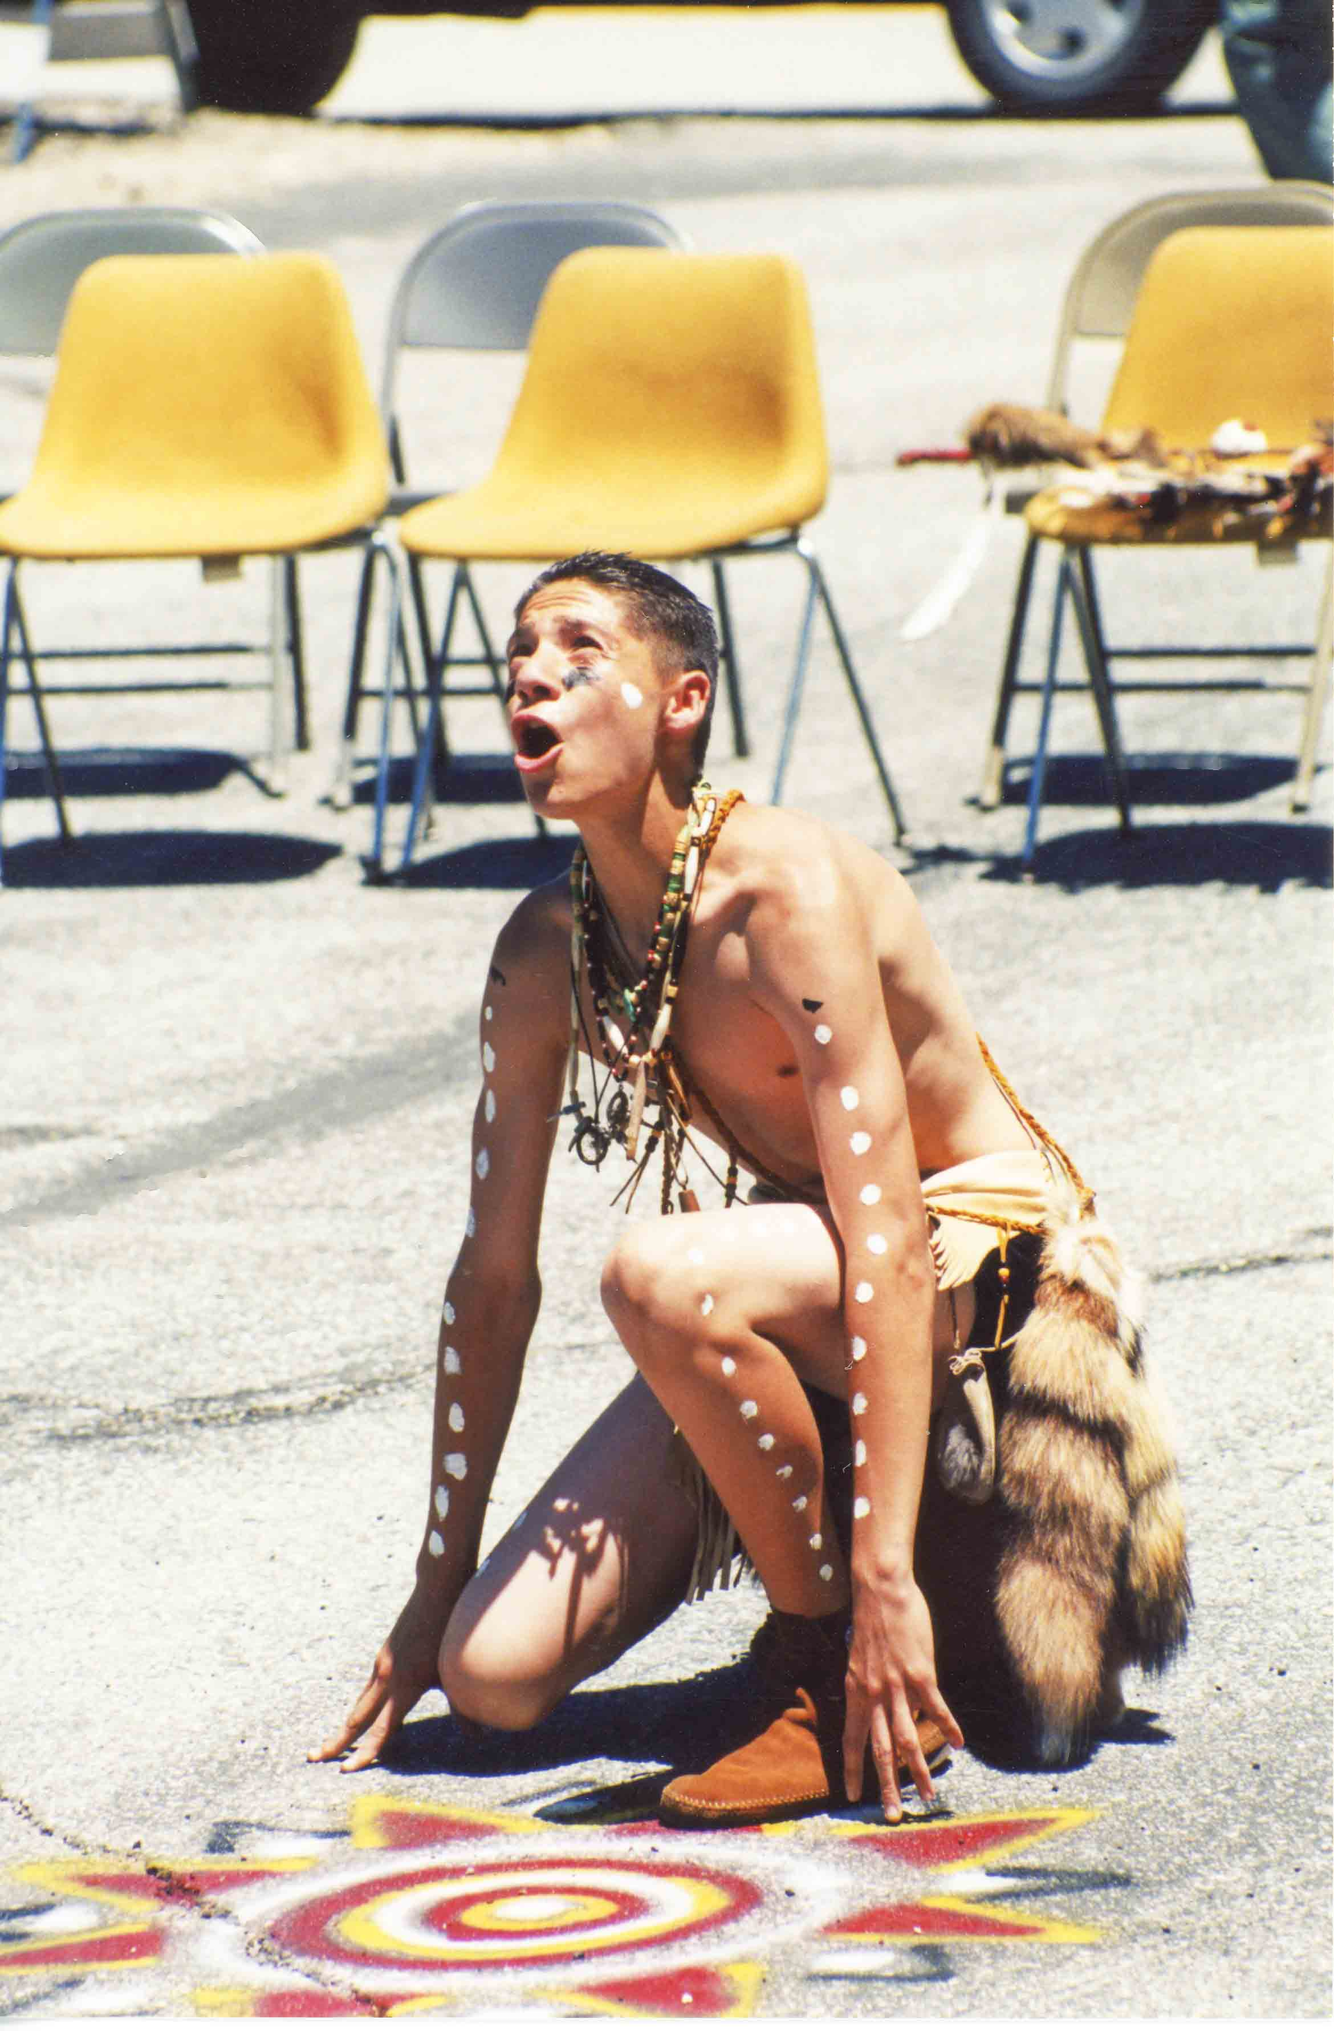
Marlene Reyes and son Michael

